Slide 1
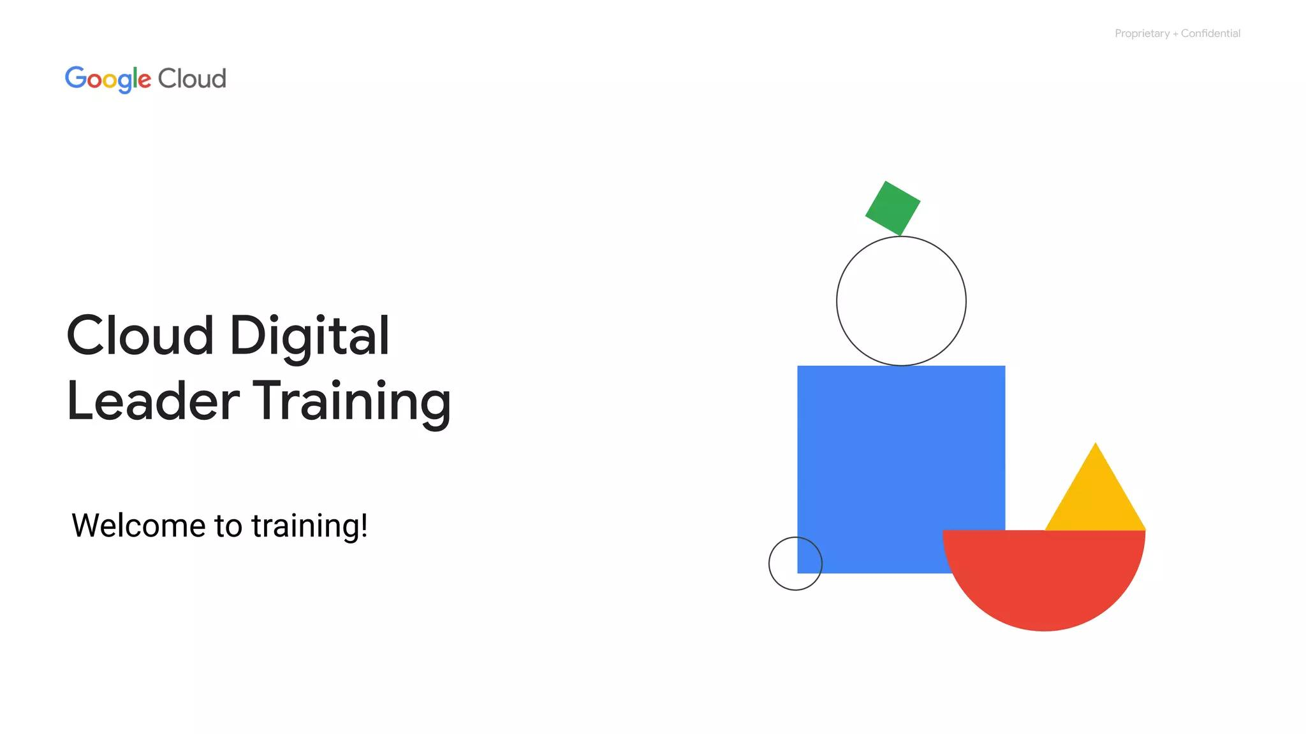
Introducing Google Cloud
Overview of cloud computing
IaaS and PaaS
Google Cloud network
Environmental impact
Security
Open APIs and open source
Pricing and billing
Notes:
This module introduces Google Cloud. It covers cloud computing, IaaS and PaaS, the Google Cloud network, environmental impact, security, open APIs/open source, pricing, and billing. It aims to answer: What is Google Cloud? How is it organized? What makes it unique?

Slide 2
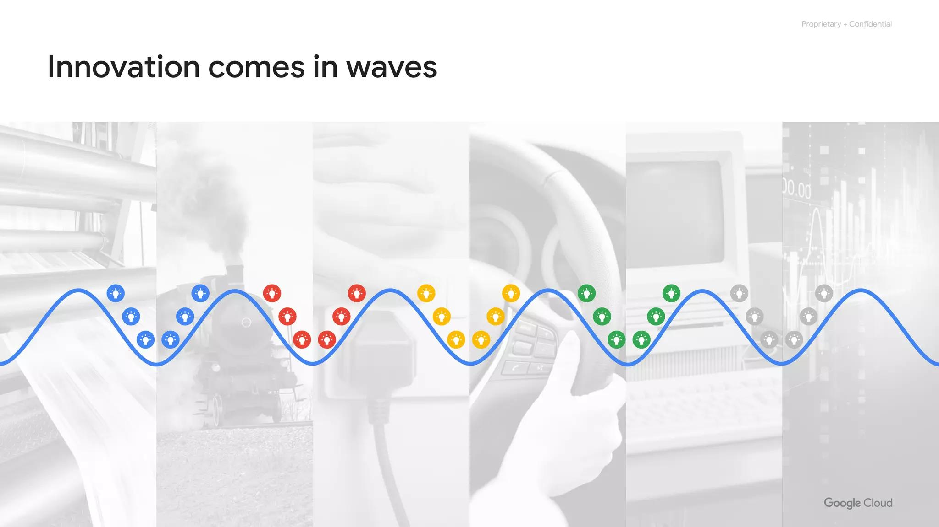
What is Cloud?
US National Institute
Standards and Technology
Cloud computing
Notes:
The cloud is a hot topic but, what exactly is it? The US National Institute of Standards and Technology created the term cloud computing, although, there is nothing US-specific about it.

Slide 3
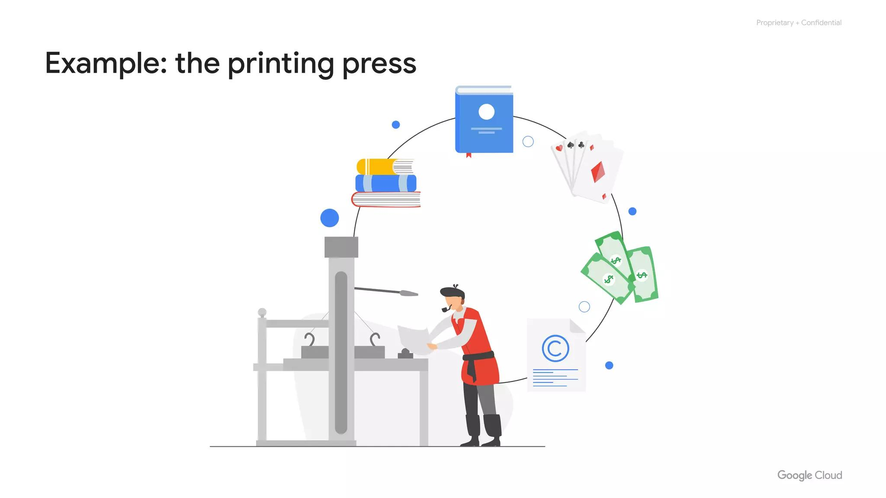
IT Traits
On-demand, self-service
Access over the internet
Provider allocates resources
Resources are elastic
Pay for use/reservation
Notes:
Cloud computing is a way of using information technology (IT) that has five equally important traits. Customers get computing resources that are on-demand and self-service, access to those resources over the internet, resources are allocated from a provider, the resources are elastic, and customers pay only for what they use, or reserve as they go.

Slide 4
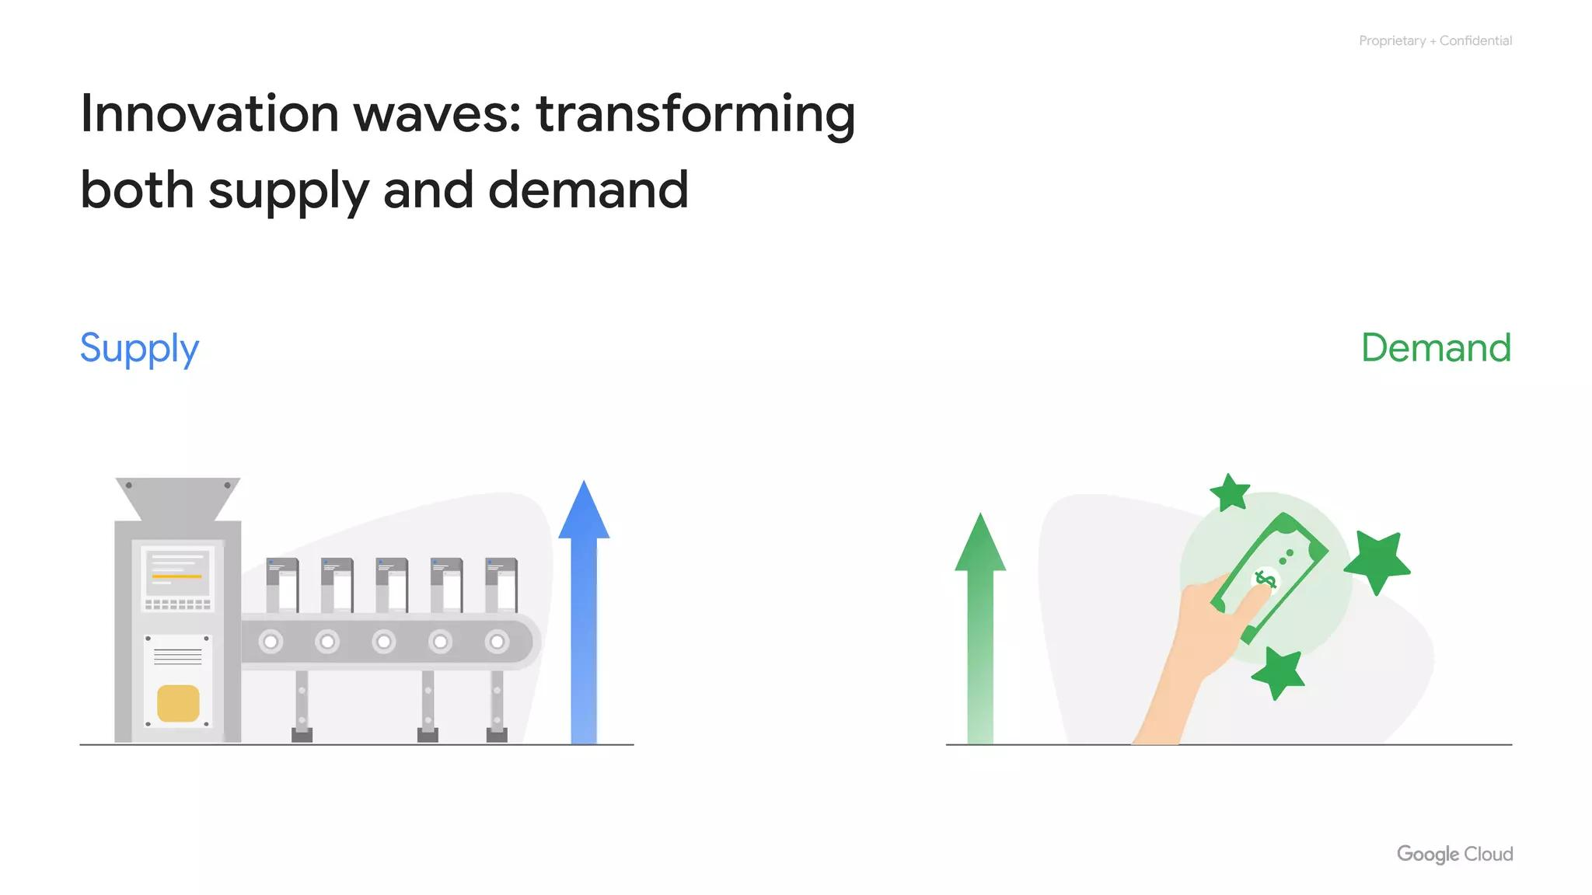
Self-Service
On-demand, self-service
Users get processing power
No need for intervention
Notes:
First, customers get computing resources that are on-demand and self-service. Through a web interface, users get the processing power, storage, and network they need with no need for human intervention.

Slide 5
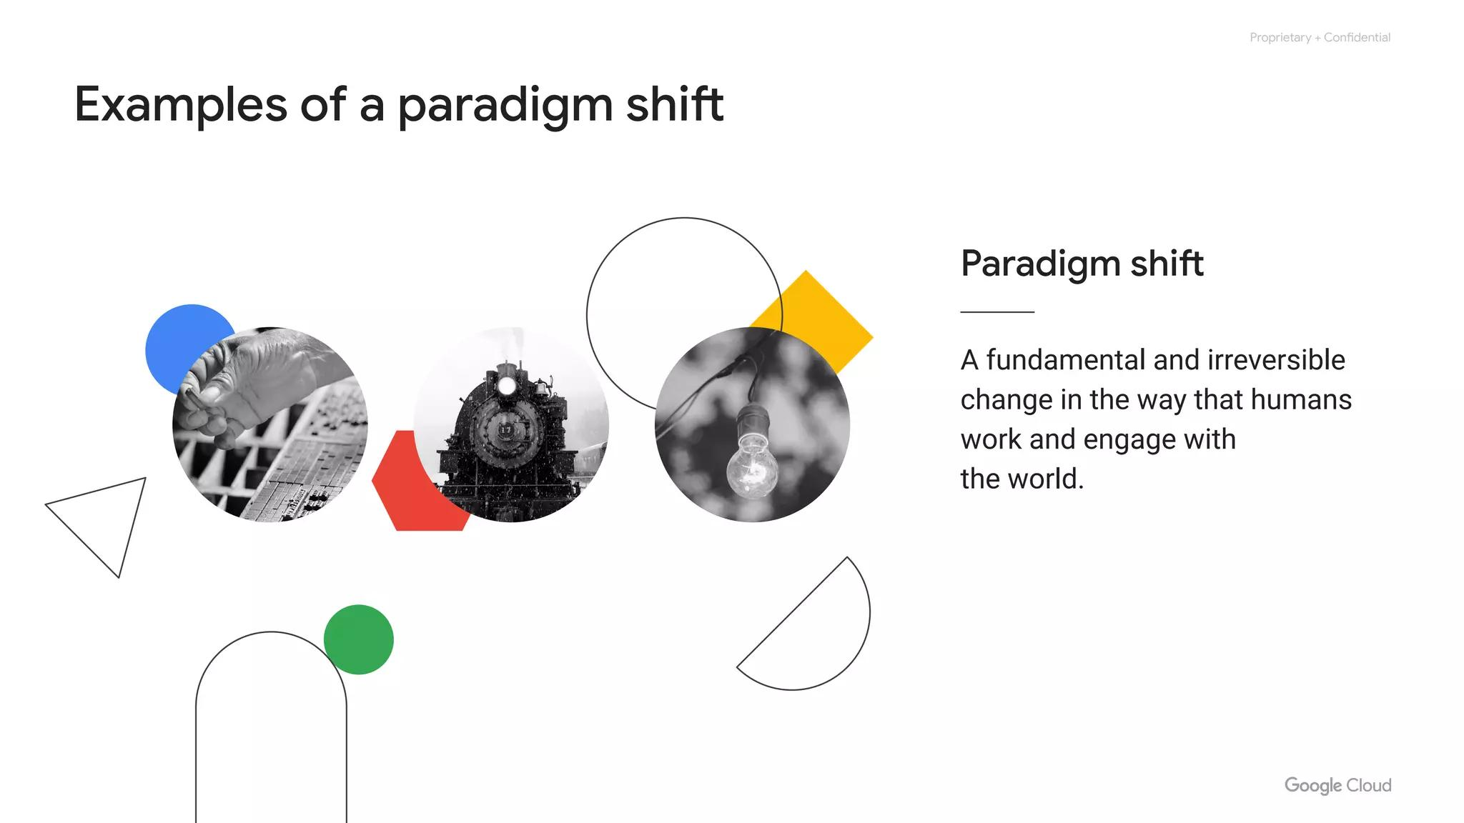
Internet Access
Access over the internet
Access to resources
From anywhere
Notes:
Second, customers get access to those resources over the internet, from anywhere they have a connection.

Slide 6
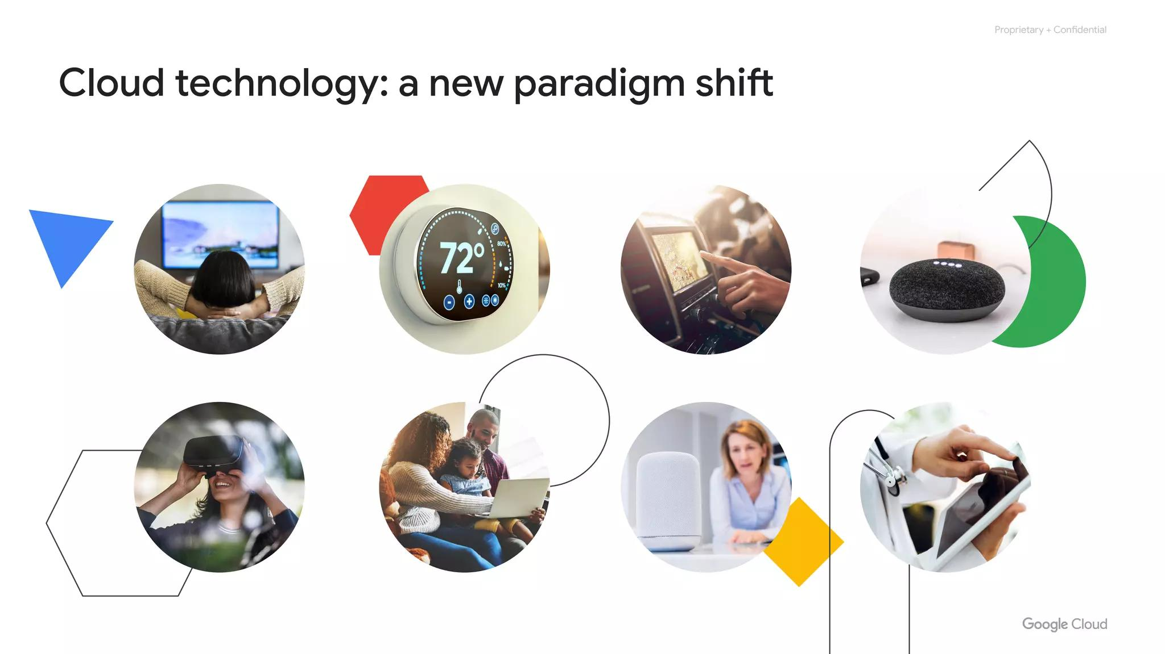
Resource Pools
Provider allocates resources
Provider buys in bulk
Savings for customers
Don't care about location
Notes:
Third, the provider of those resources has a big pool of them, and allocates them to users out of that pool. That allows the provider to buy in bulk and pass the savings on to the customers. Customers don't have to know or care about the exact physical location of those resources.

Slide 7
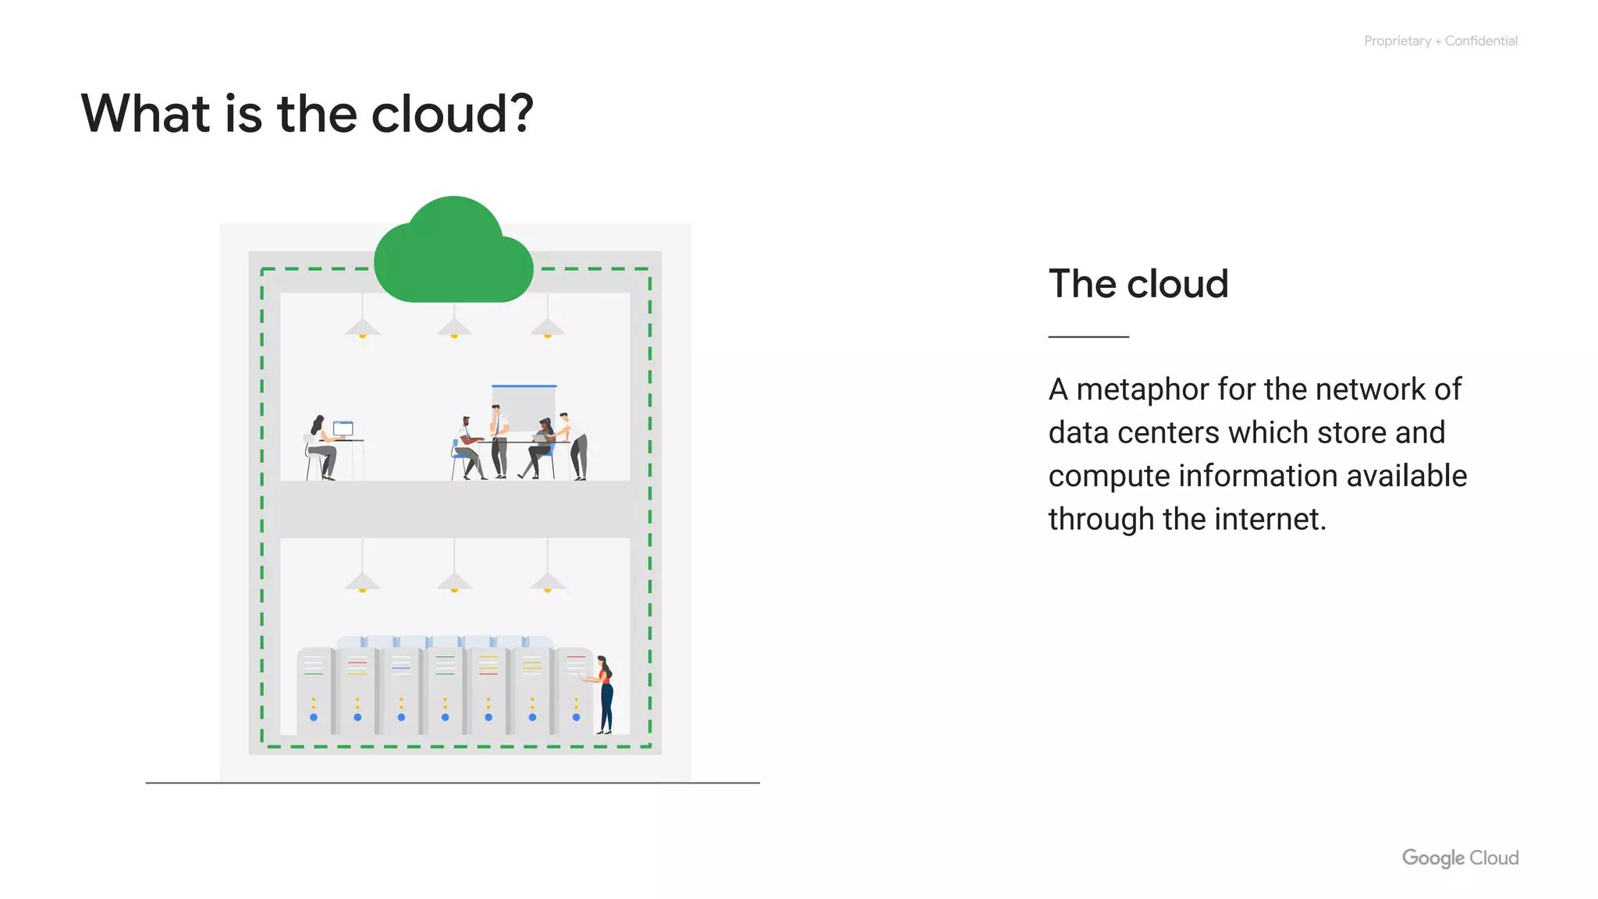
Resource Elasticity
Resources are elastic
Flexible resources
Scale up and down
Notes:
Fourth, the resources are elastic–which means they’re flexible, so customers can be. If they need more resources they can get more, and quickly. If they need less, they can scale back.

Slide 8
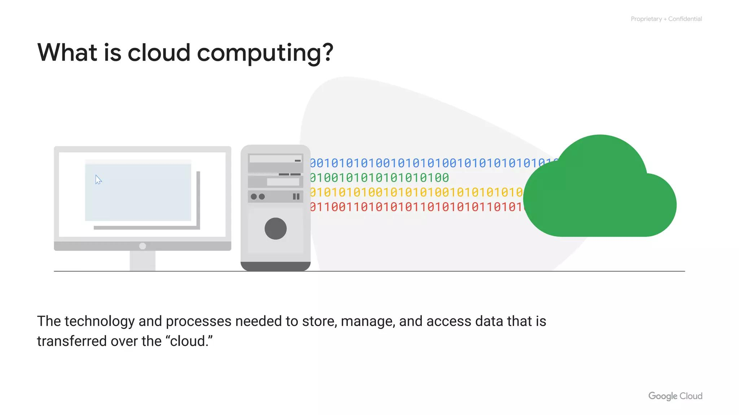
Pay-As-You-Go
Pay for use/reservation
Stop using, stop paying
Notes:
And finally, the customers pay only for what they use, or reserve as they go. If they stop using resources, they stop paying. That's it. That's the definition of cloud.

Slide 9
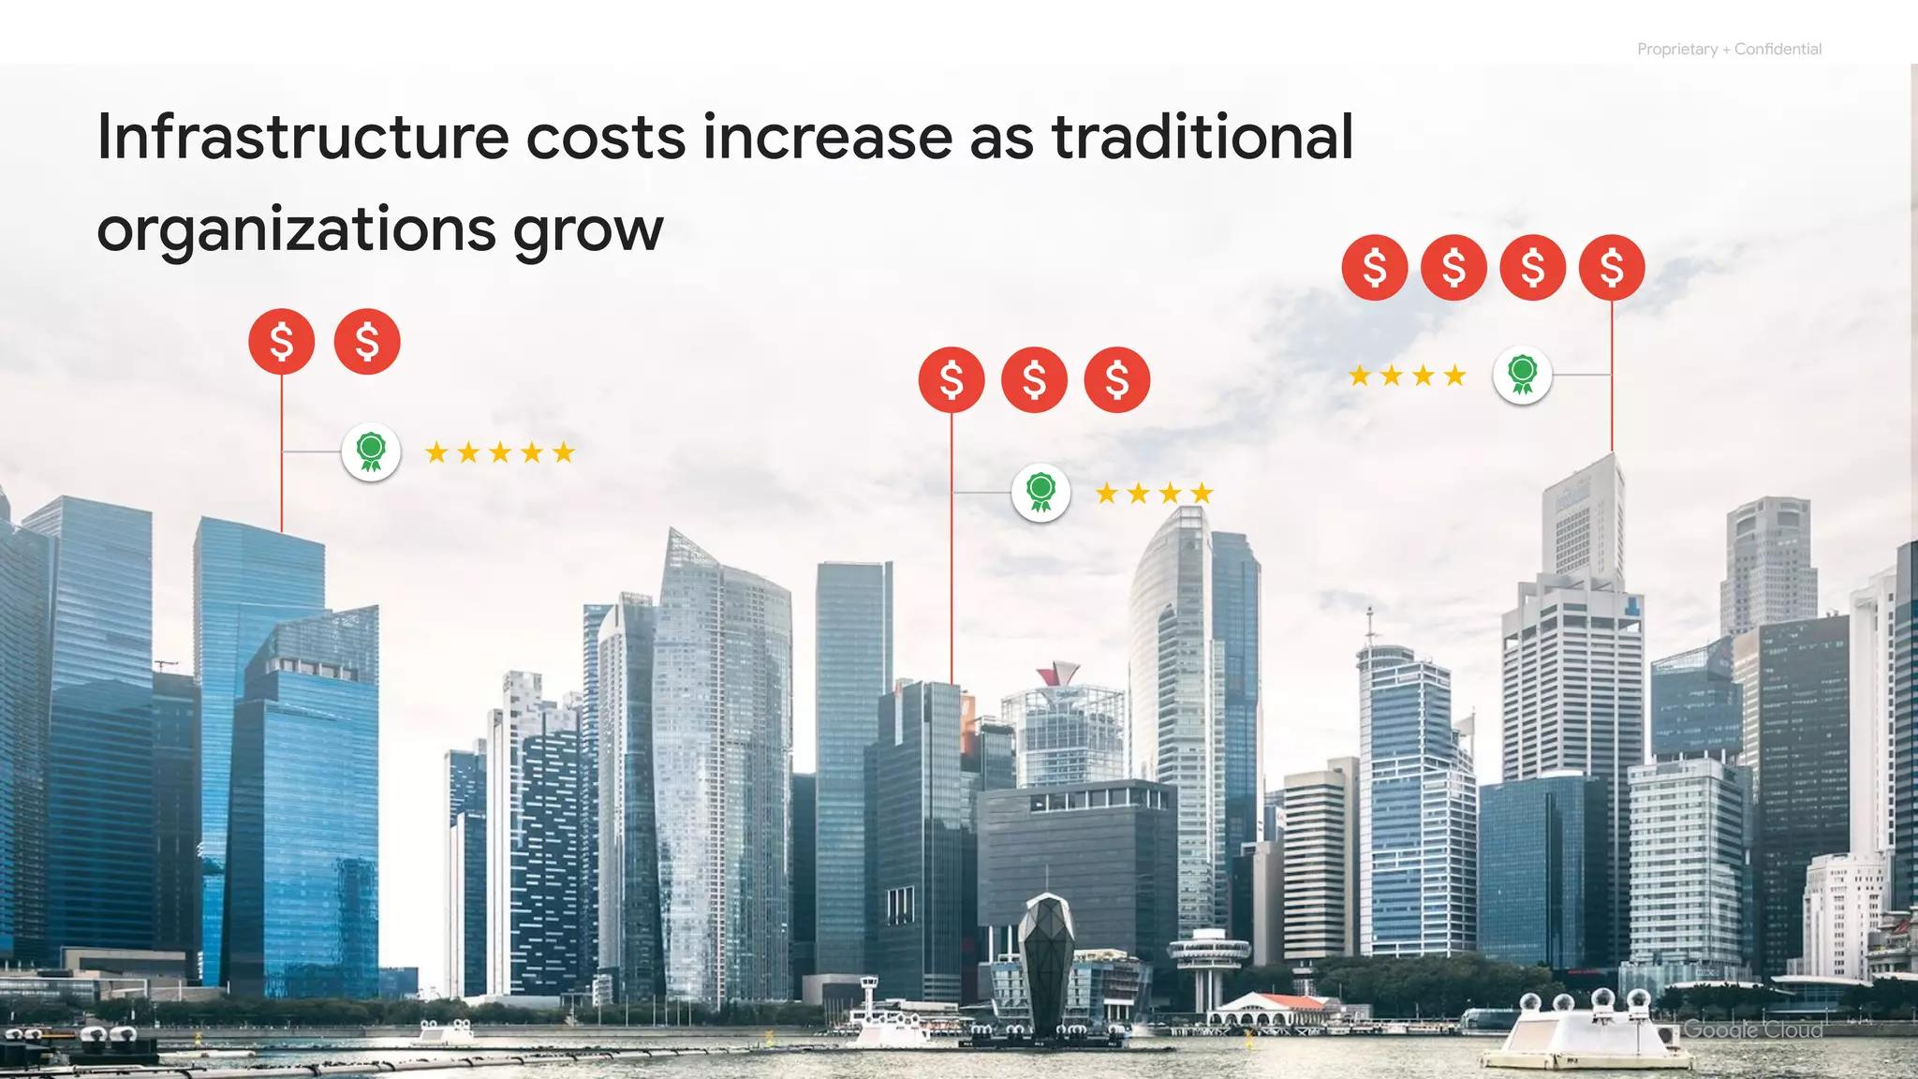
Cloud History - Colocation
First Wave: Rent
Colocation
Financial efficiency
Notes:
To understand why the cloud model is so compelling nowadays, we need to look at some history. The trend towards cloud computing started with a first wave with something called colocation. Colocation gave users the financial efficiency of renting physical space, instead of investing in data center real estate.

Slide 10
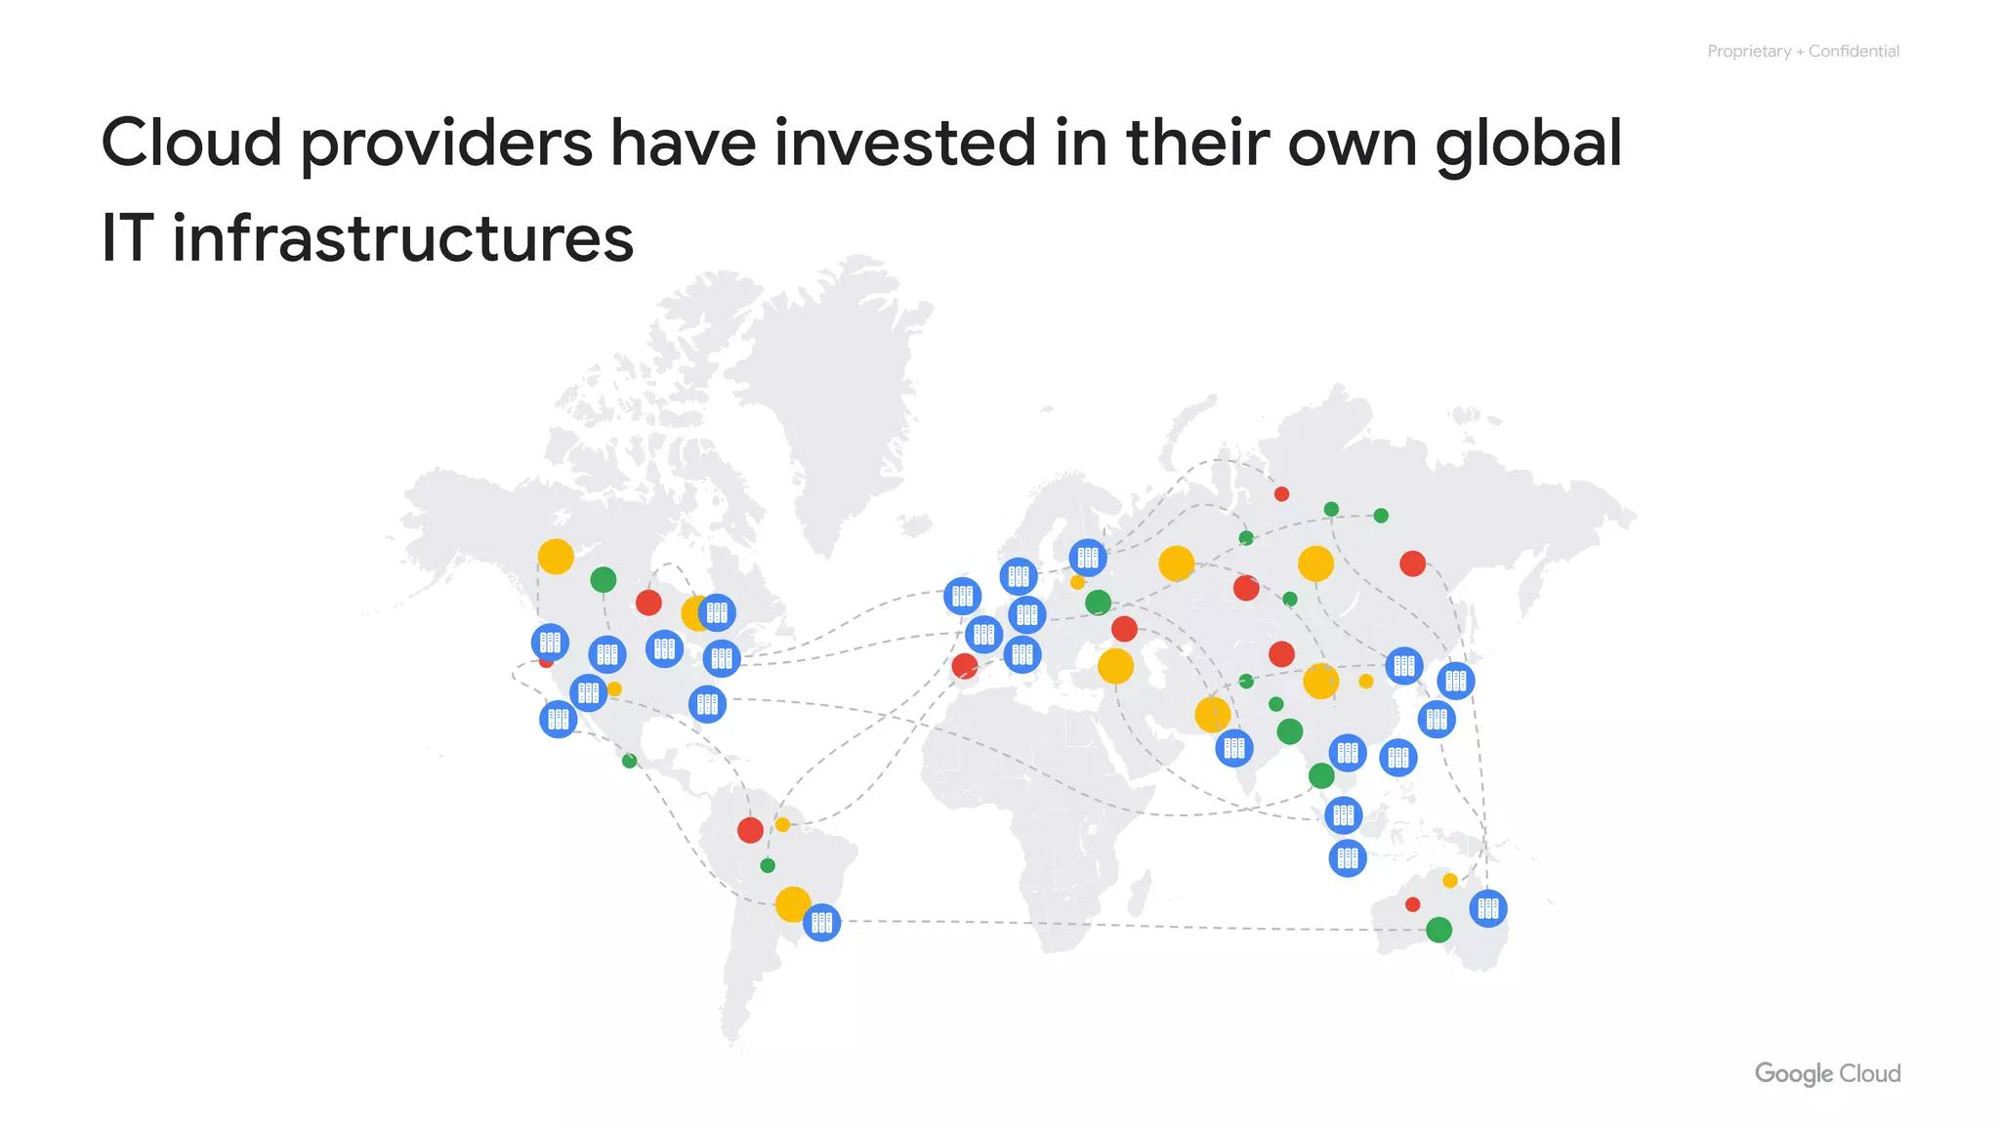
Cloud History - Virtualization
Second Wave
Virtualized data centers
Share similarities with past
Notes:
Virtualized data centers of today, which is the second wave, share similarities with the private data centers and colocation facilities of decades past. The components of virtualized data centers match the physical building blocks of hosted computing—servers, CPUs, disks, load balancers, and so on—but now they’re virtual devices.

Slide 11
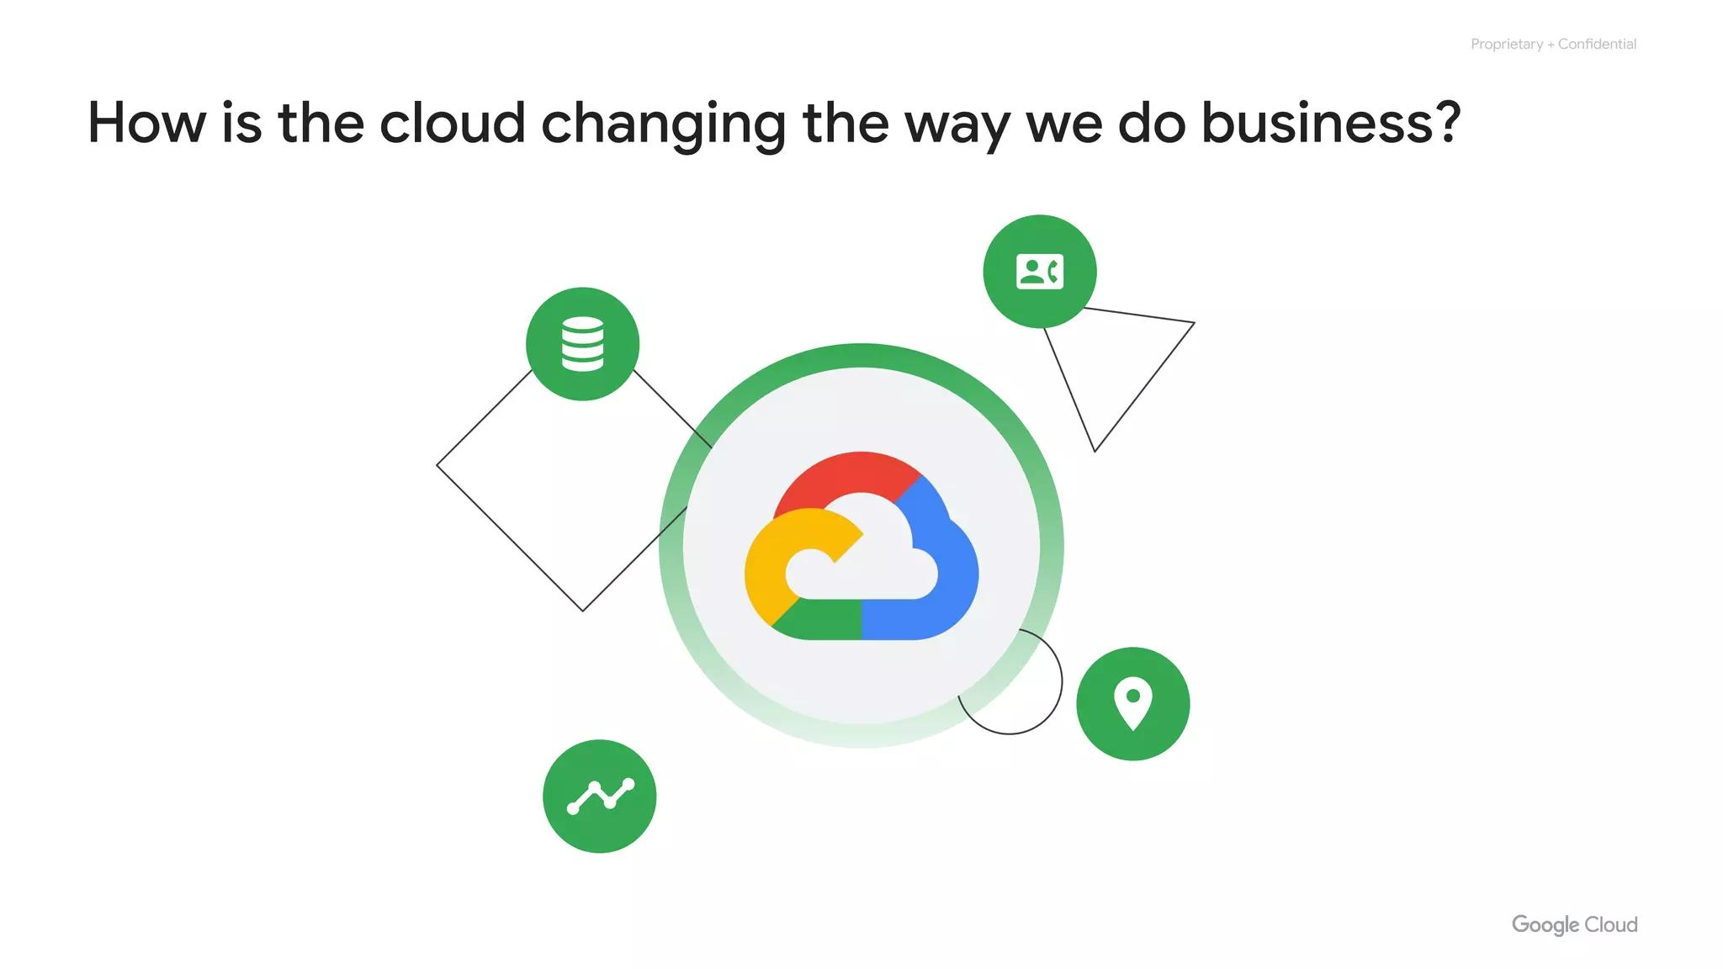
User-Controlled Environment
User-controlled environment
User-configured environment
Enterprises maintain infrastructure
Notes:
With virtualization, enterprises still maintained the infrastructure; it’s still a user-controlled and user-configured environment.

Slide 12
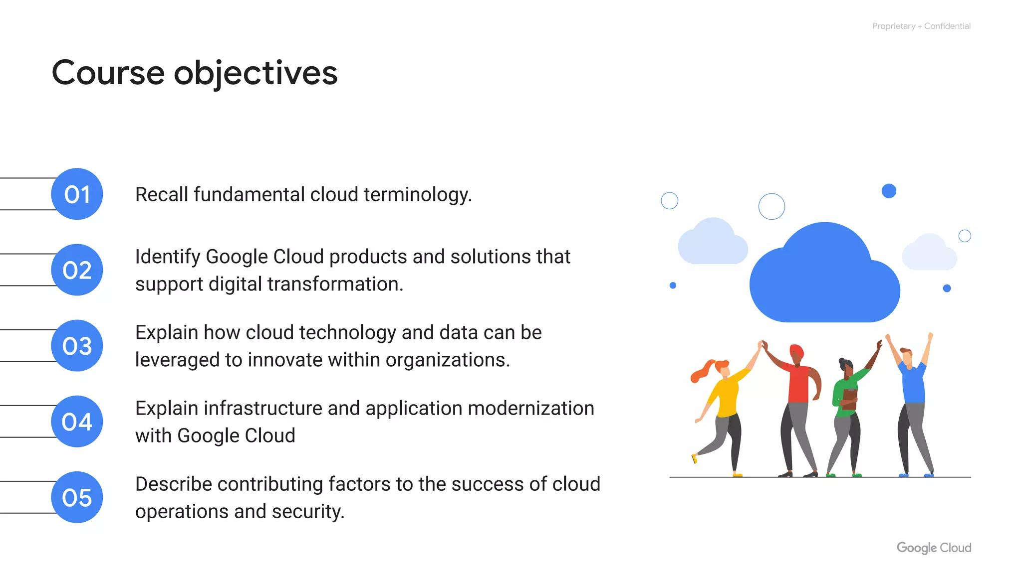
Cloud History - Containers
Third Wave
Container-based architecture
Automated and elastic cloud
Notes:
Several years ago, Google realized that its business couldn’t move fast enough within the confines of the virtualization model. So Google switched to a container-based architecture—a fully automated, elastic third-wave cloud that consists of a combination of automated services and scalable data. Services automatically provision and configure the infrastructure used to run applications.

Slide 13
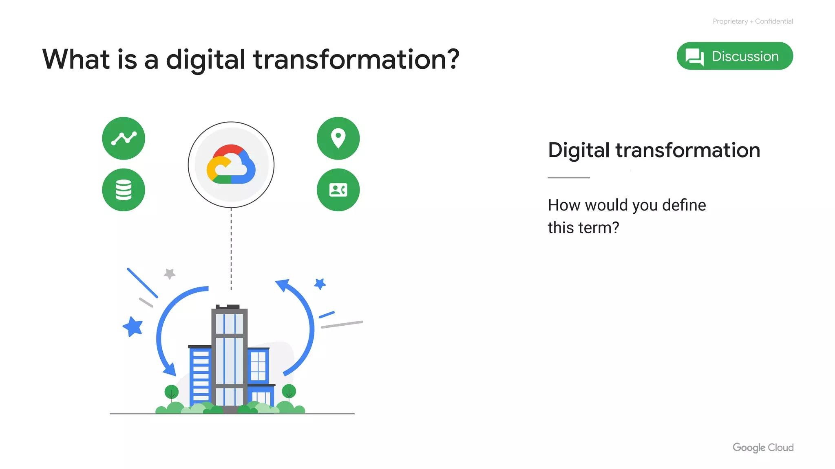
Google Cloud Today
Third-wave cloud available
Every company is a data company
Software is key
Notes:
Today, Google Cloud makes this third-wave cloud available to Google customers. Google believes that, in the future, every company—regardless of size or industry—will differentiate itself from its competitors through technology. Increasingly, that technology will be in the form of software. Great software is based on high-quality data. This means that every company is, or will eventually become, a data company.

Slide 14
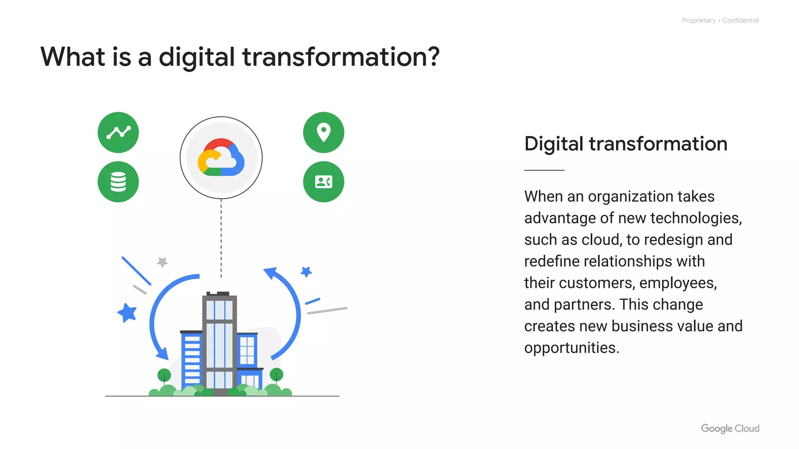
Cloud Service Offerings
PaaS - Platform as a service
IaaS - Infrastructure as a service
Notes:
This move to virtualized data centers introduced customers to two new types of offerings: infrastructure as a service, commonly referred to as IaaS, and platform as a service, or PaaS.

Slide 15
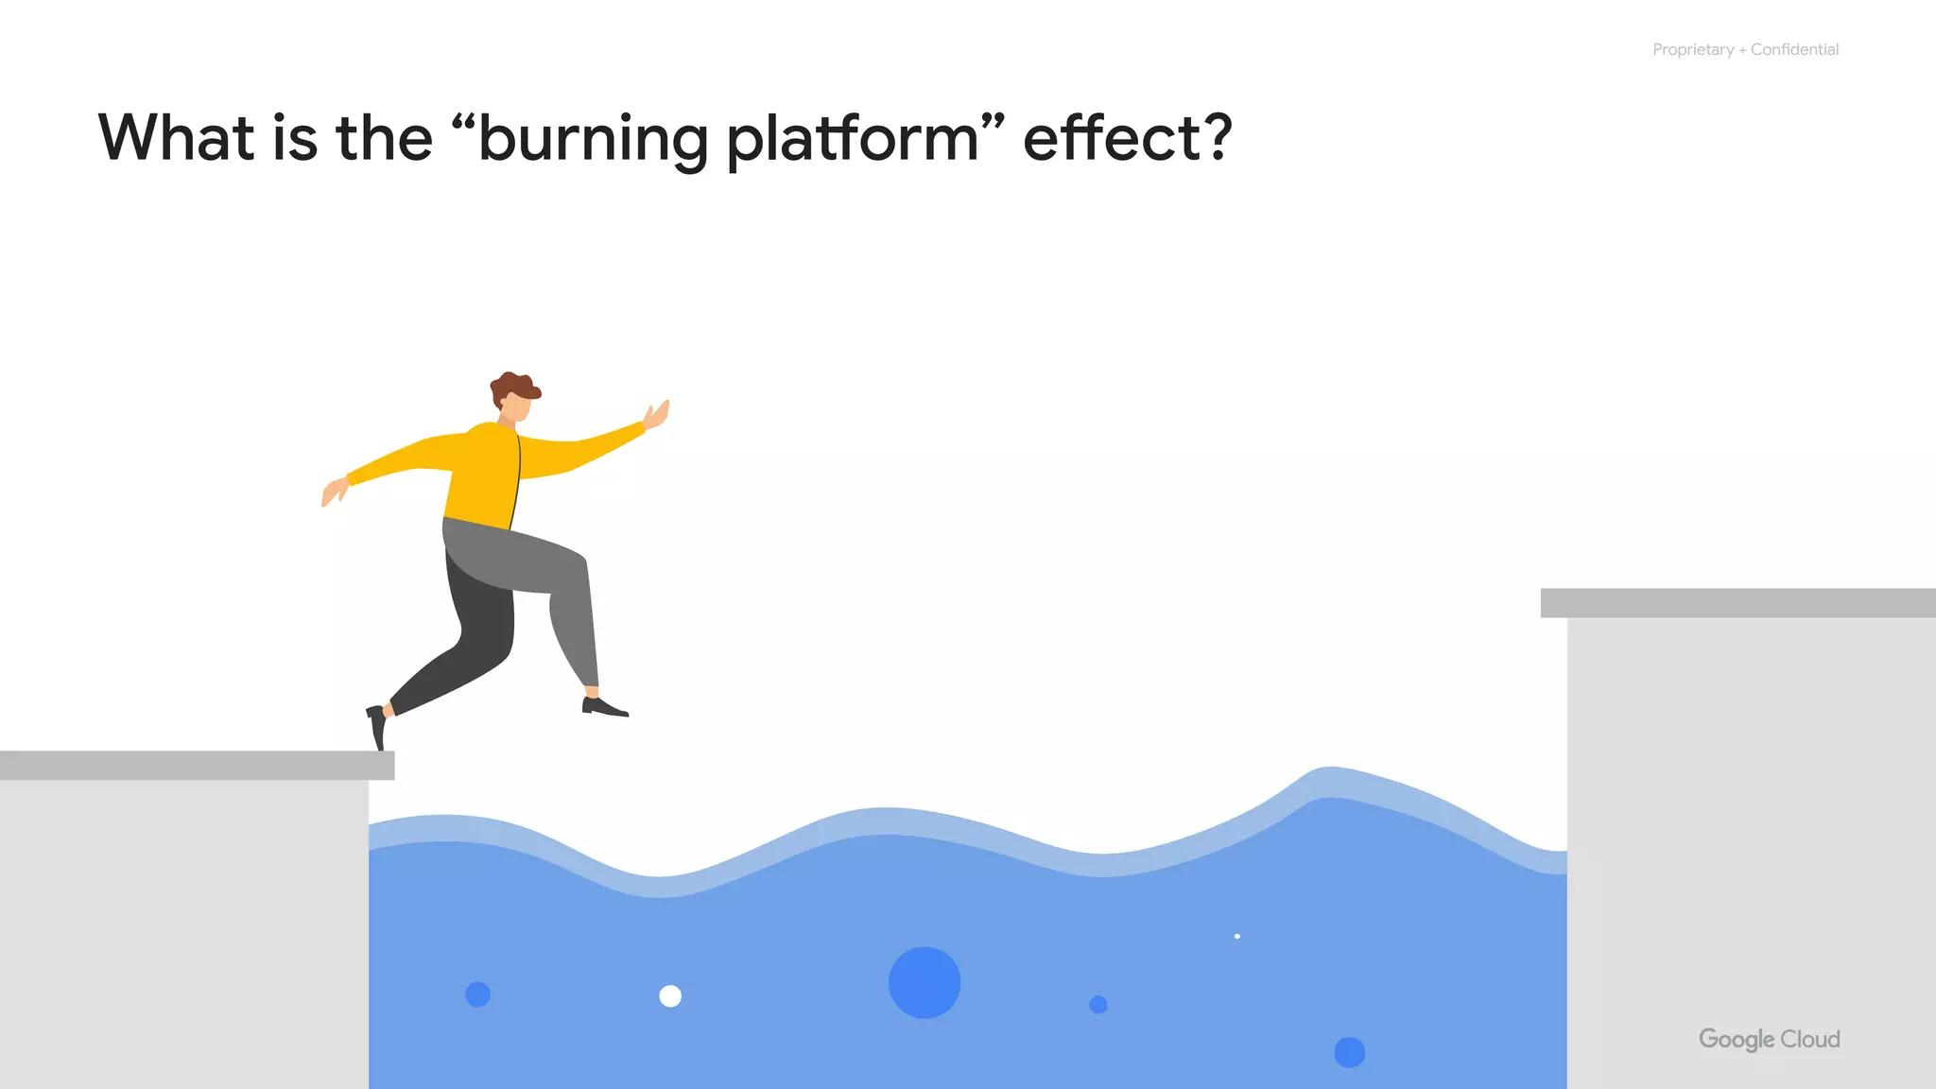
IaaS
IaaS provides on-demand
Infrastructure via the cloud
Storage
Raw compute
Network capabilities
Notes:
IaaS delivers on-demand infrastructure resources via the cloud, such as raw compute, storage, and network capabilities, organized virtually into resources that are similar to physical data centers. Compute Engine is an example of a Google Cloud IaaS service.

Slide 16
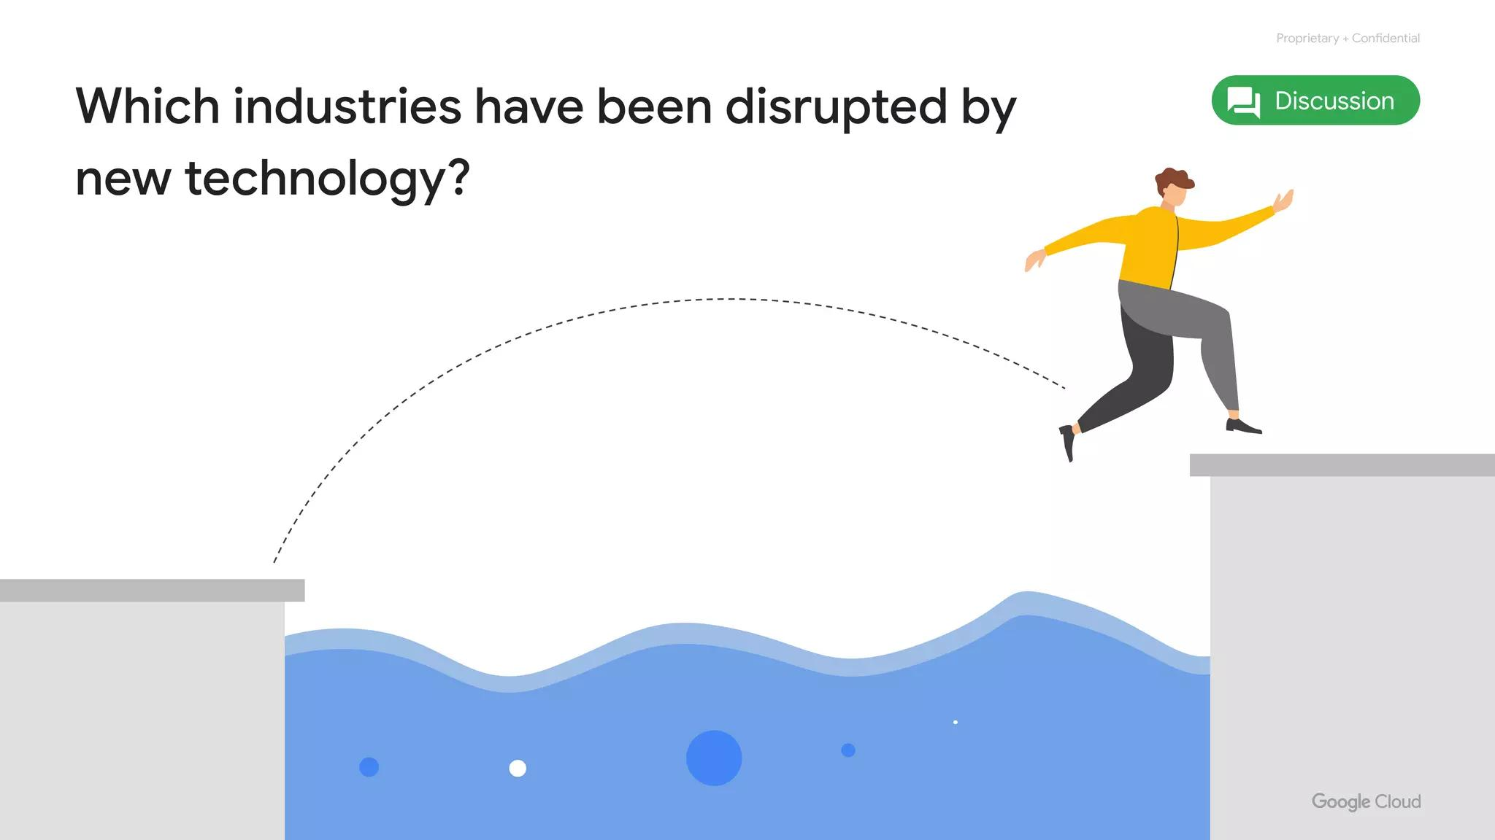
PaaS
PaaS manages hardware/software
Bind code to libraries
Focus on application logic
Notes:
PaaS delivers and manages all the hardware and software through the cloud. PaaS offerings, on the other hand, bind code to libraries that provide access to the infrastructure application needs. This allows more resources to be focused on application logic. App Engine is an example of a Google Cloud PaaS service.

Slide 17
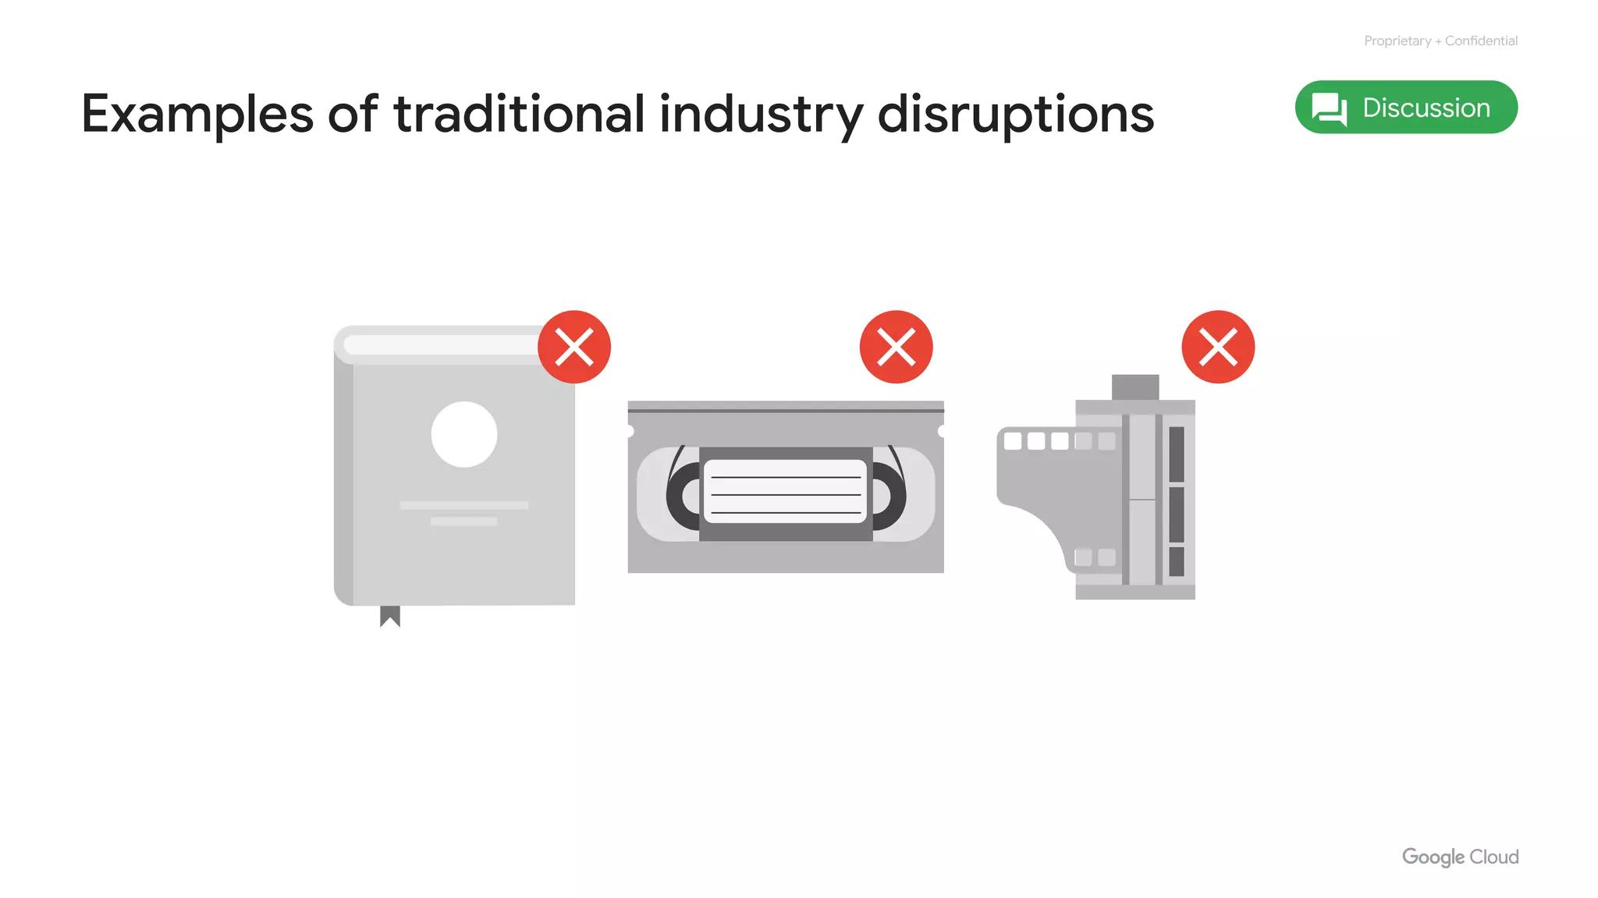
Payment Models
IaaS: Pay for allocation
PaaS: Pay for use
Notes:
In the IaaS model, customers pay for the resources they allocate ahead of time; in the PaaS model, customers pay for the resources they actually use.

Slide 18
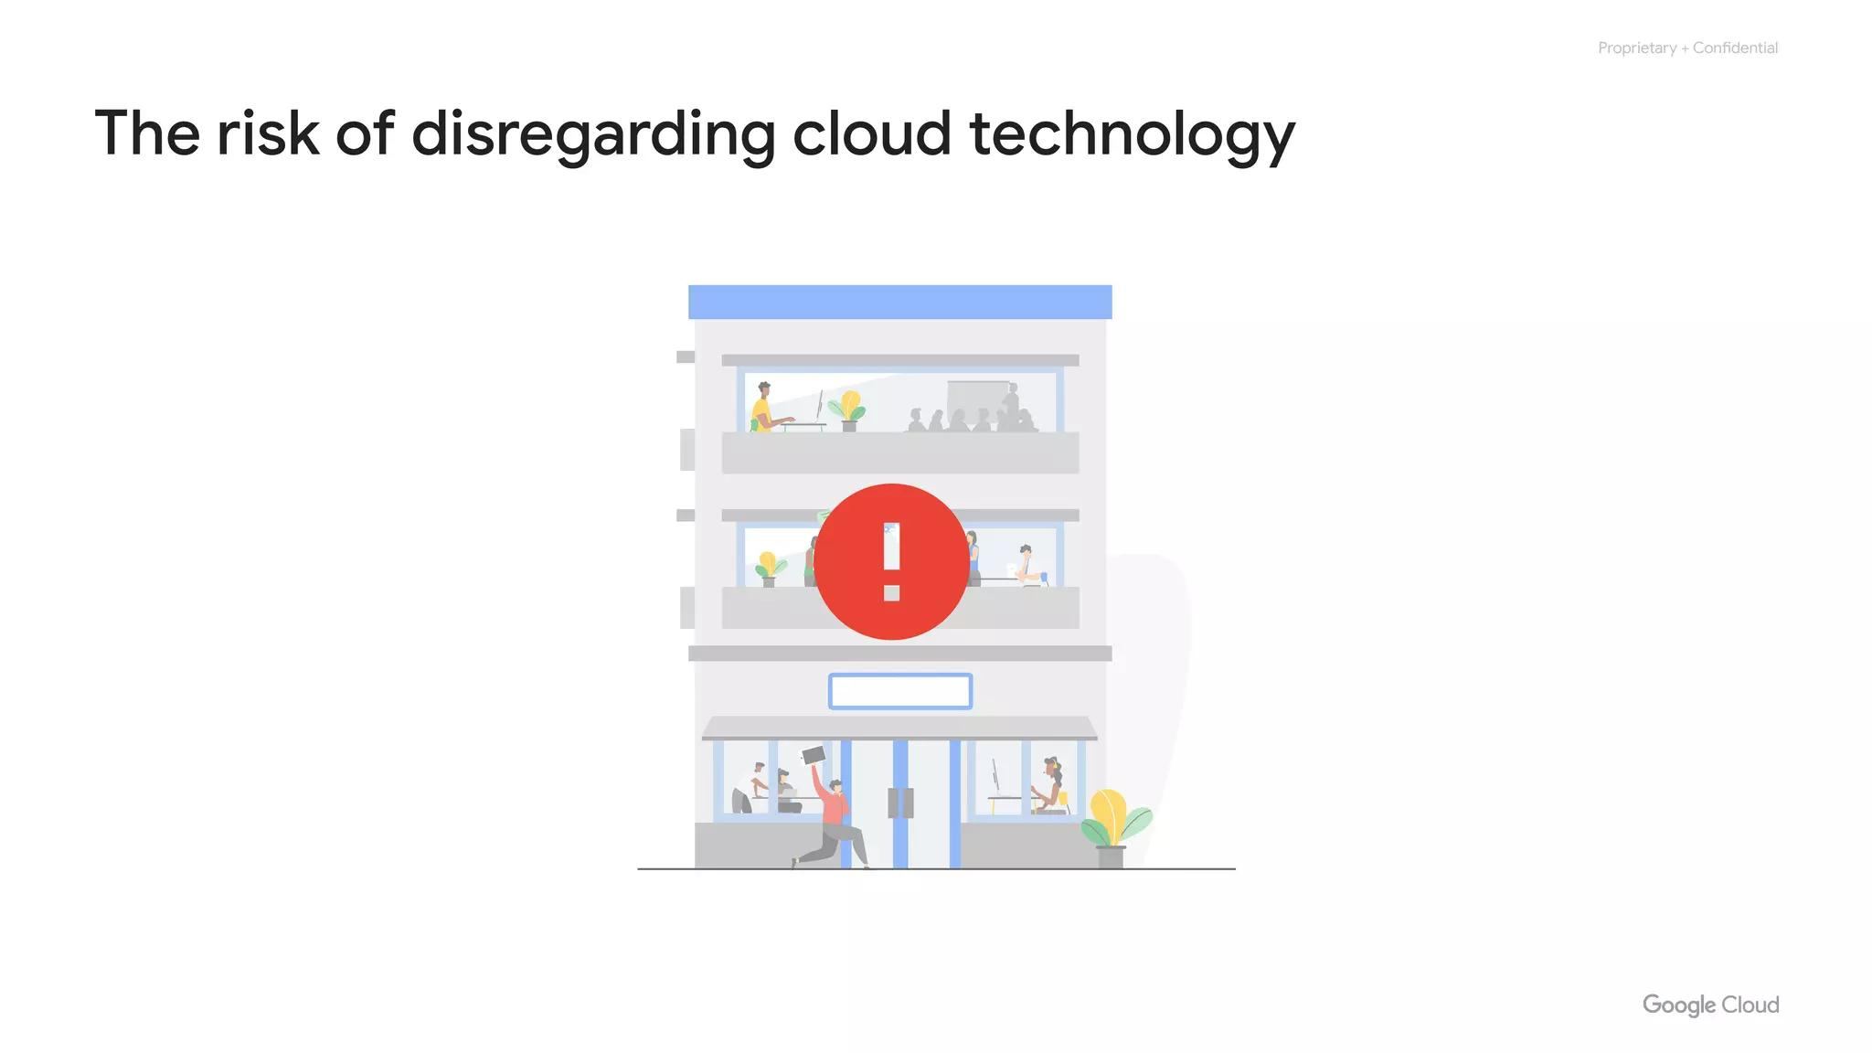
Evolution of Cloud
Managed resources
Managed services
Deliver products/services
More reliably and quickly
Notes:
As cloud computing has evolved, the momentum has shifted toward managed infrastructure and managed services. Leveraging managed resources and services allows companies to concentrate more on their business goals and spend less time and money on creating and maintaining their technical infrastructure. It allows companies to deliver products and services to their customers more quickly and reliably. Serverless computing allows developers to concentrate on their code, rather than on server configuration, by eliminating the need for any infrastructure management.

Slide 19
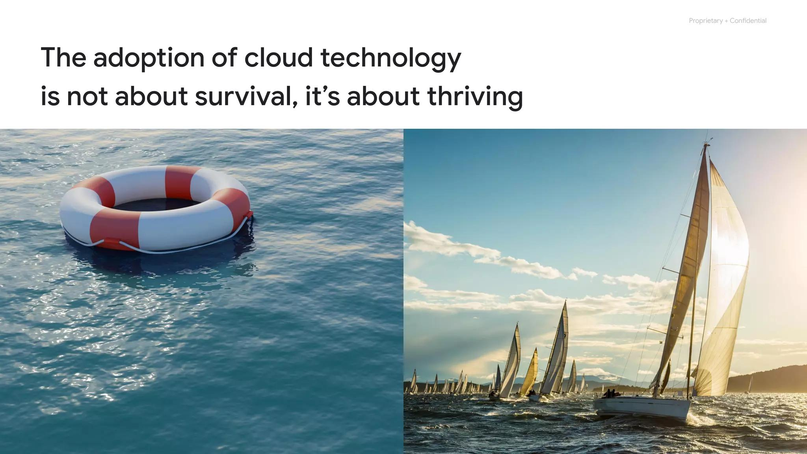
SaaS
Entire application stack
Accessed over the internet
Google Workspace examples
Notes:
SaaS provides the entire application stack, delivering an entire cloud-based application that customers can access and use. Software as a Service applications are not installed on your local computer - they run in the cloud as a service and are consumed directly over the internet by end users. Google's popular applications like Gmail, Docs, and Drive, collectively known as Google Workspace, are all classified as SaaS.

Slide 20
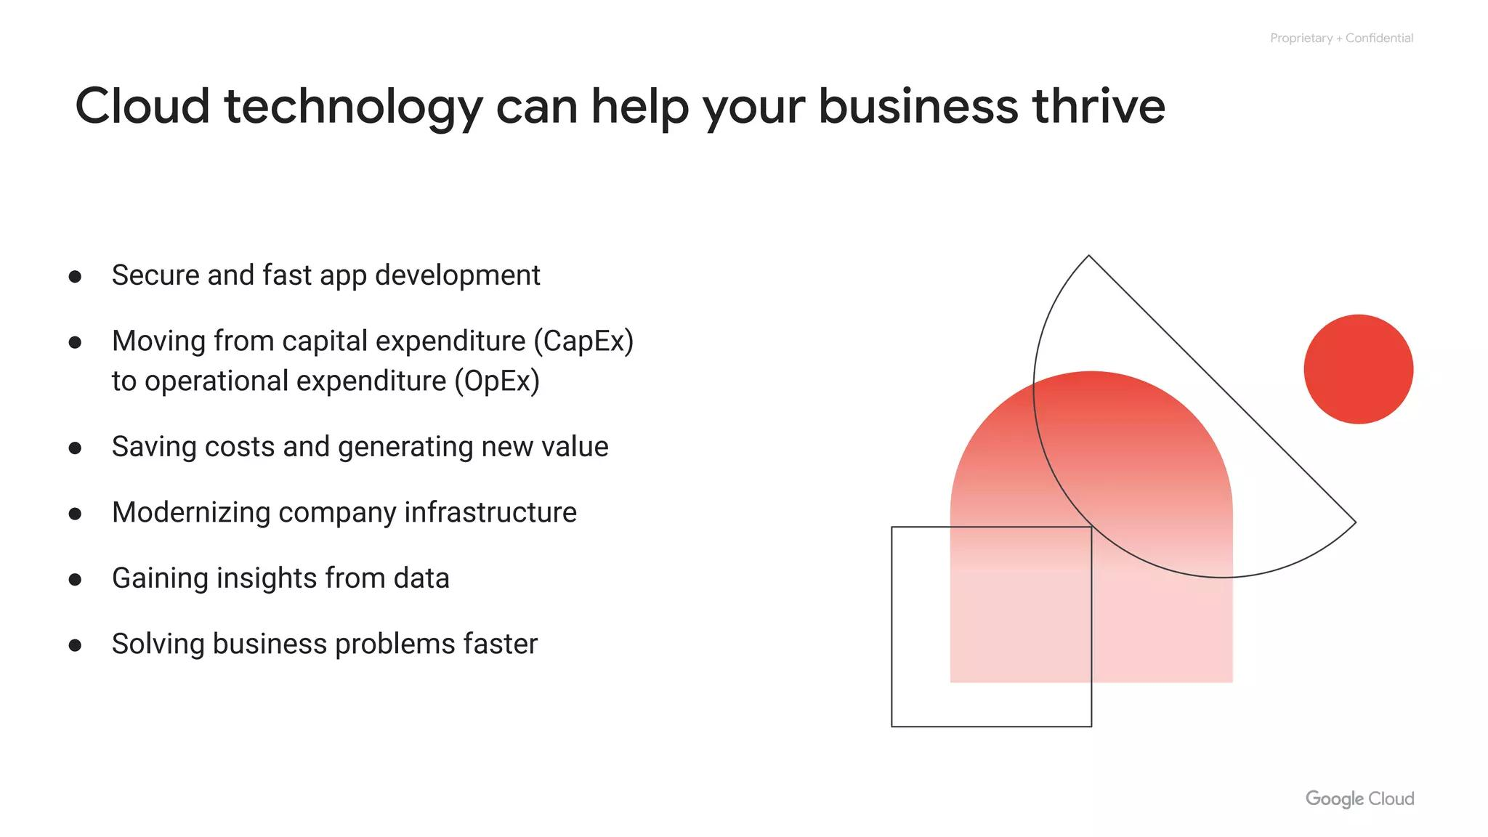
Google Cloud Network
IaaS and PaaS
Google Cloud network
Environmental impact
Security
Open APIs and open source
Pricing and billing
Notes:
Now that we’ve learned about or had a refresher on the basics of cloud computing, let’s explore Google’s own network that Google Cloud runs on.

Slide 21
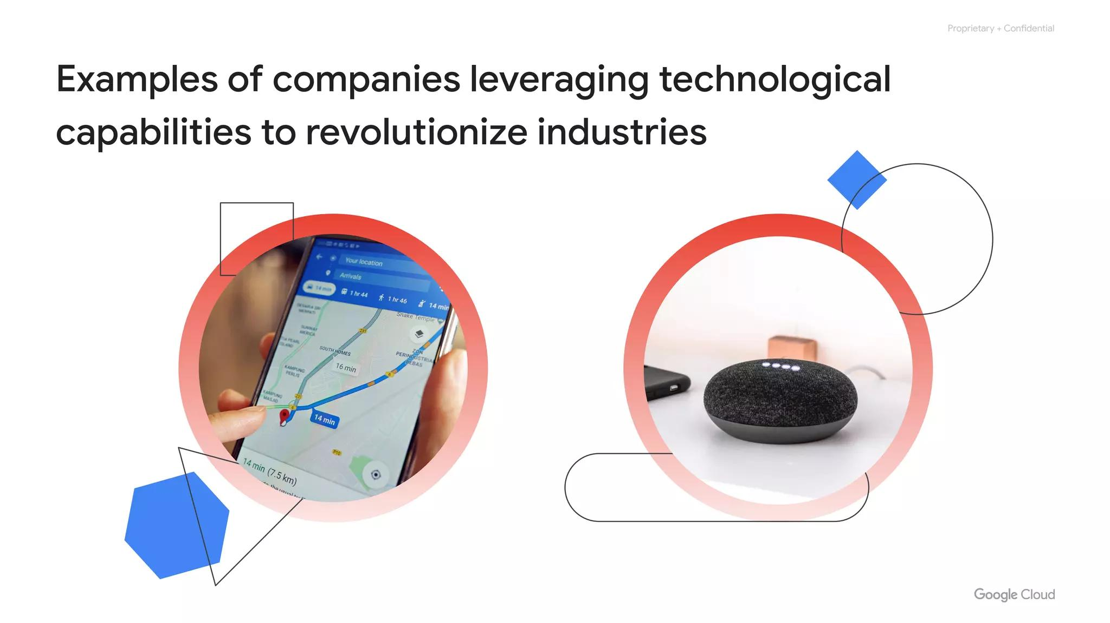
Google's Network
Largest network of its kind
Billions of dollars invested
Notes:
Google’s network is the largest network of its kind, and Google has invested billions of dollars over the years to build it.

Slide 22
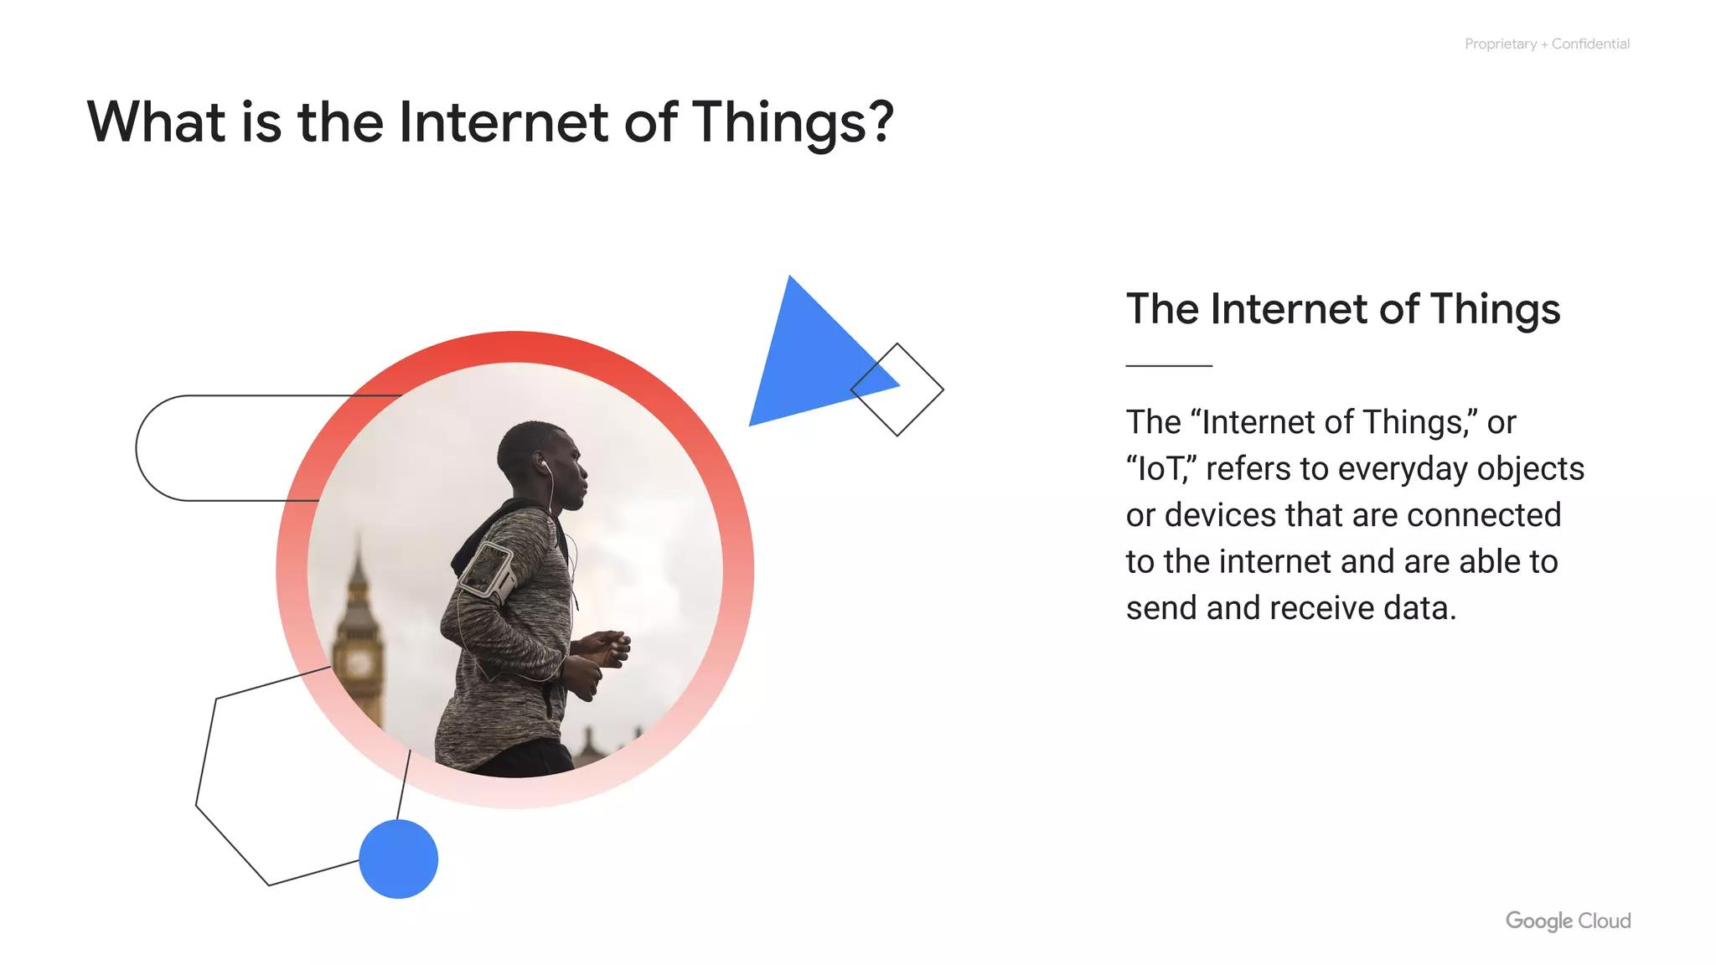
High Throughput Design
High throughput
Low latencies
>100 caching nodes
Notes:
Google’s global network is designed to give customers the highest possible throughput and lowest possible latencies for their applications by leveraging more than 100 content caching nodes worldwide–which are locations where high demand content is cached for quicker access–to respond to user requests from the location that will provide the quickest response time.

Slide 23
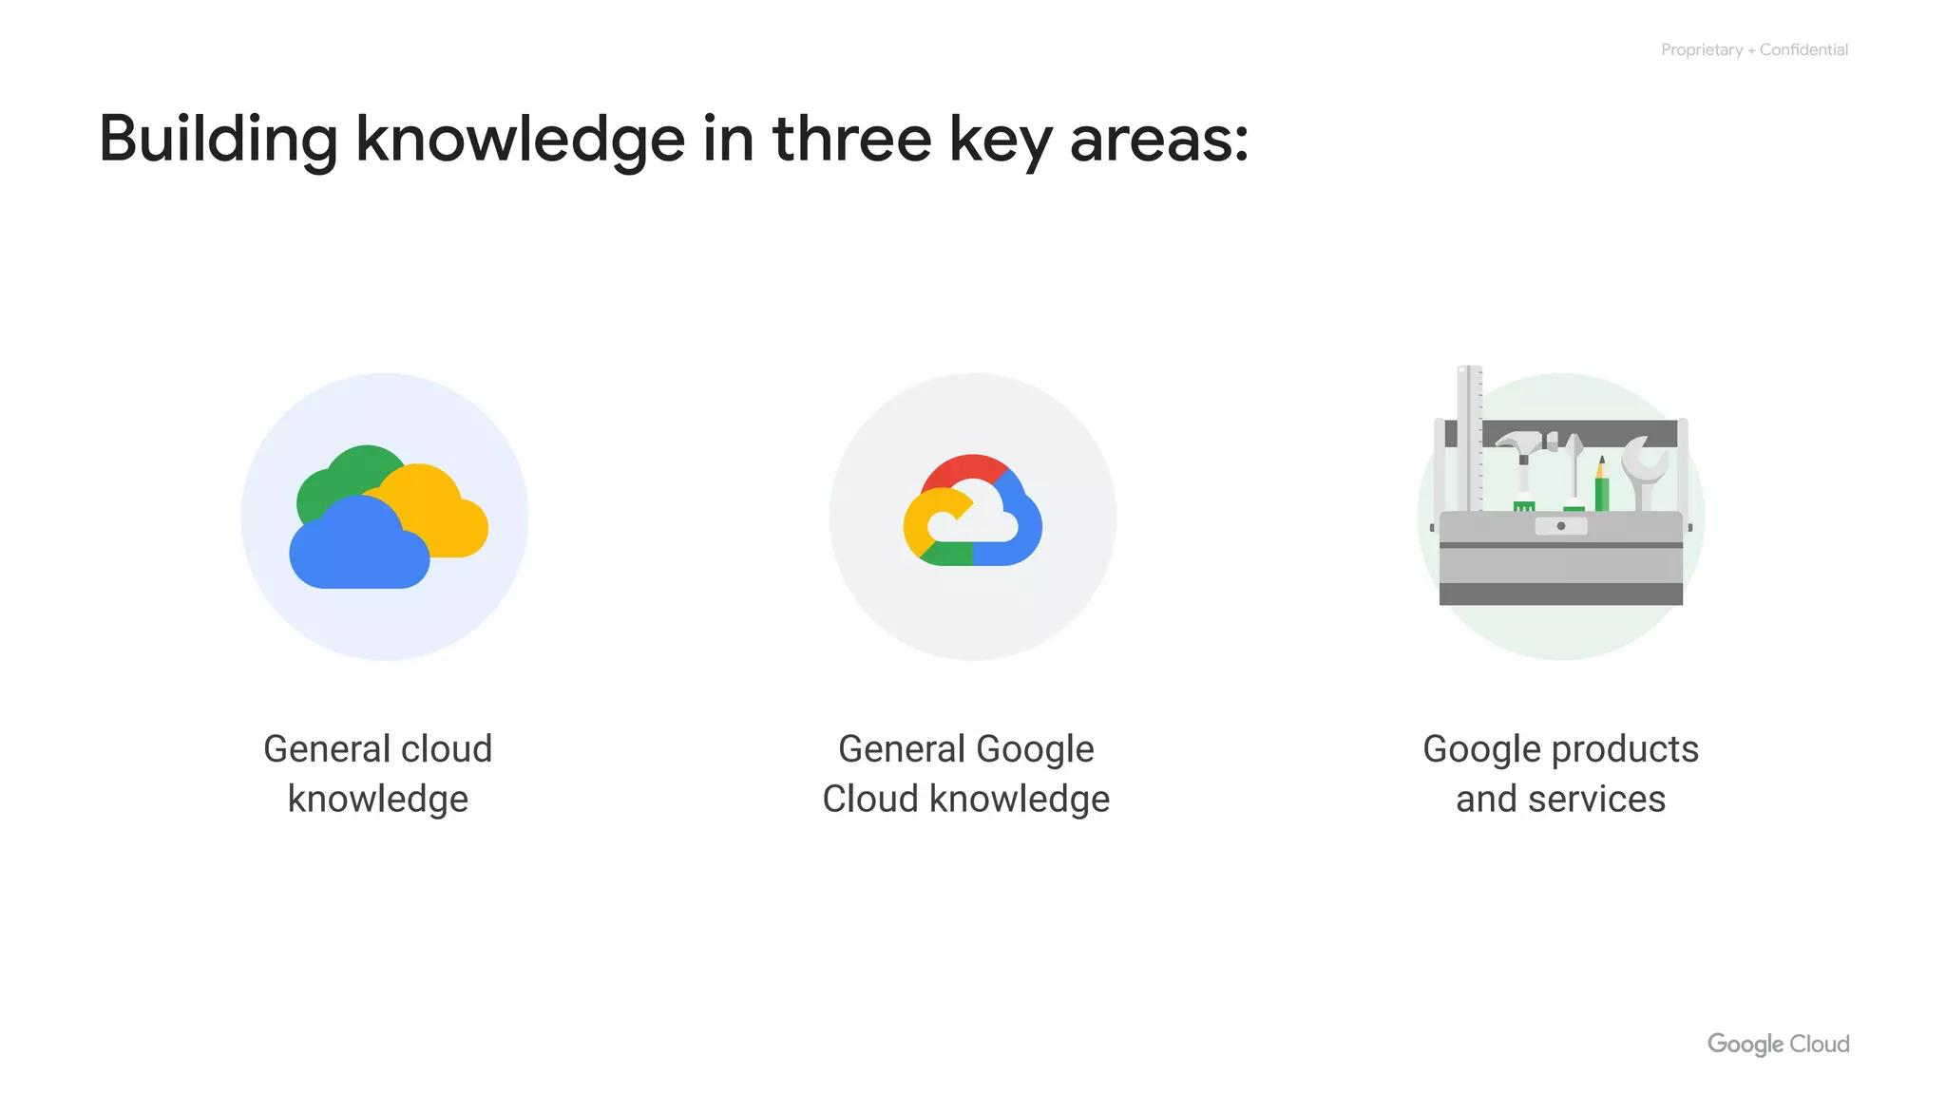
Infrastructure Locations
North America
South America
Europe
Asia
Australia
Notes:
Google Cloud’s infrastructure is based in five major geographic locations: North America, South America, Europe, Asia, and Australia. Having multiple service locations is important because choosing where to locate applications affects qualities like availability, durability, and latency, the latter of which measures the time a packet of information takes to travel from its source to its destination.

Slide 24
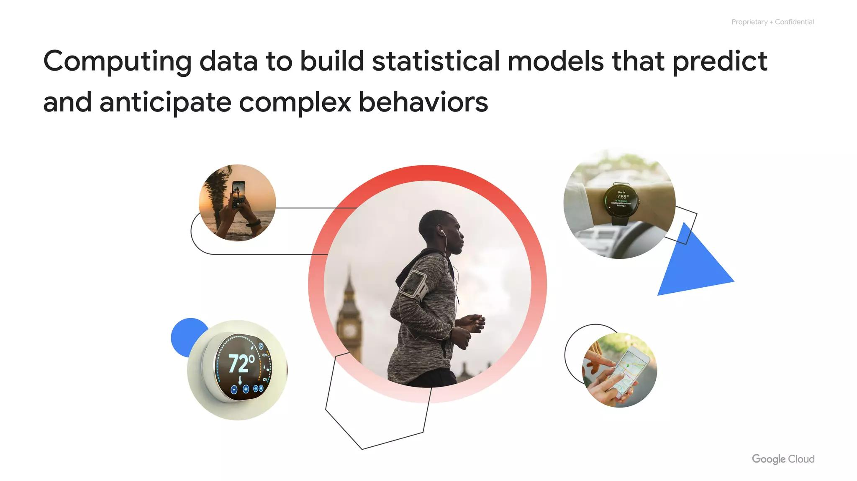
Regions and Zones
Location
Regions
Zones
Notes:
Each of these locations are divided into a number of different regions and zones.

Slide 25
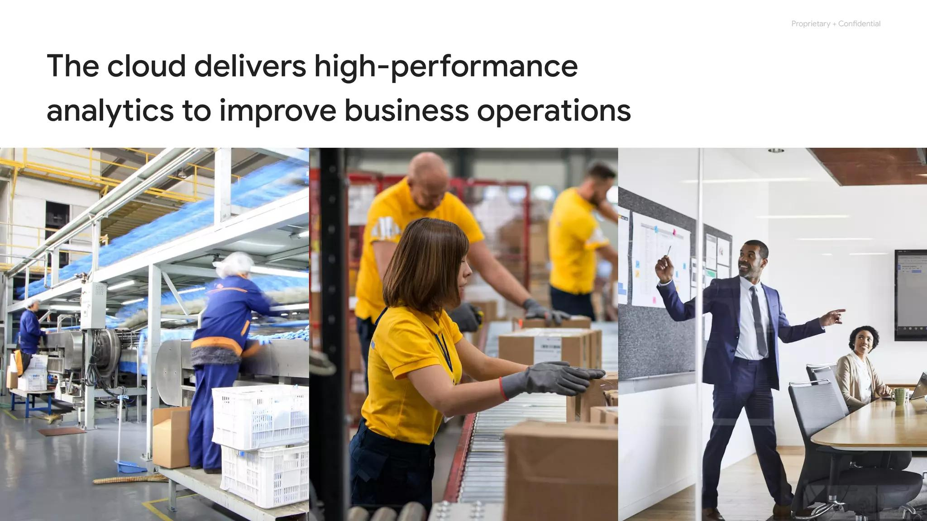
Regions Contain Zones
Region
Zones
London/europe-west2
Notes:
Regions represent independent geographic areas, and are composed of zones. For example, London, or europe-west2, is a region that currently comprises three different zones.

Slide 26
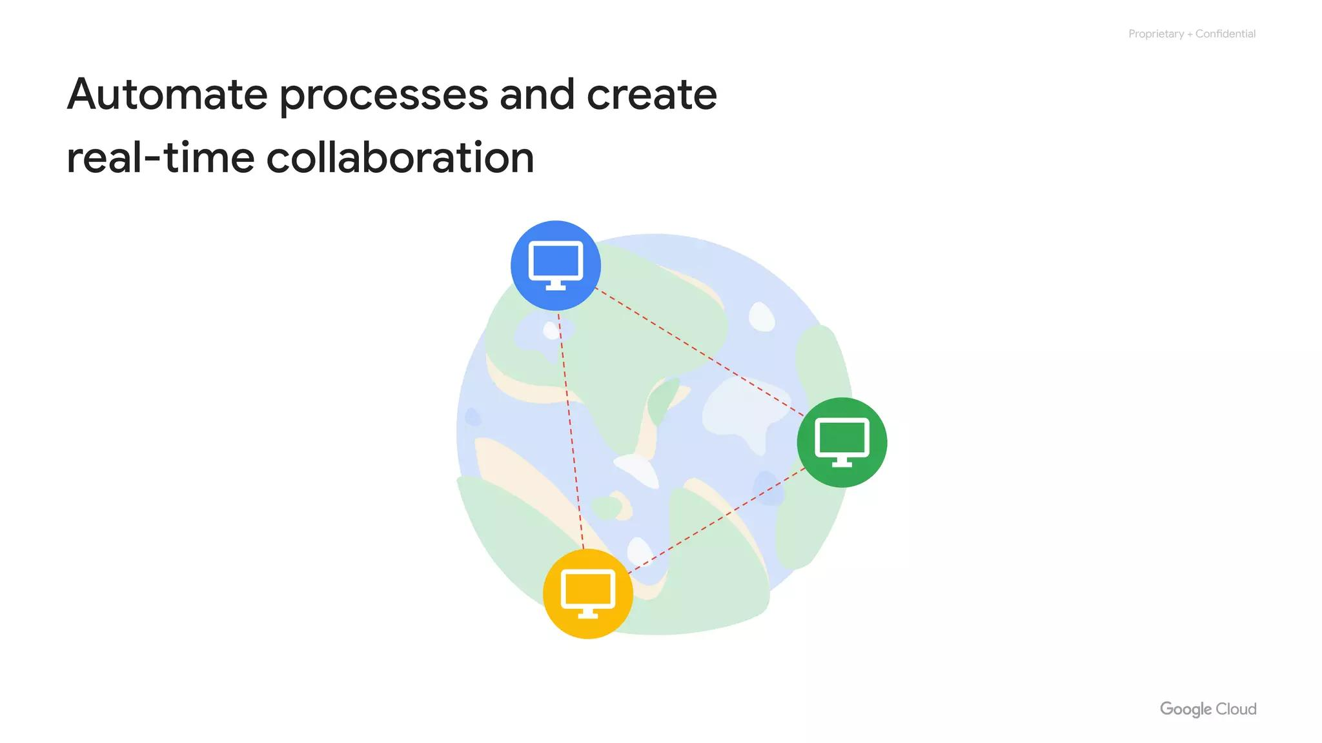
Resource Redundancy
Zones are where resources deploy
Virtual Machine
Notes:
A zone is an area where Google Cloud resources get deployed. For example, let’s say you launch a virtual machine using Compute Engine–more about Compute Engine in a bit–it will run in the zone that you specify to ensure resource redundancy.

Slide 27
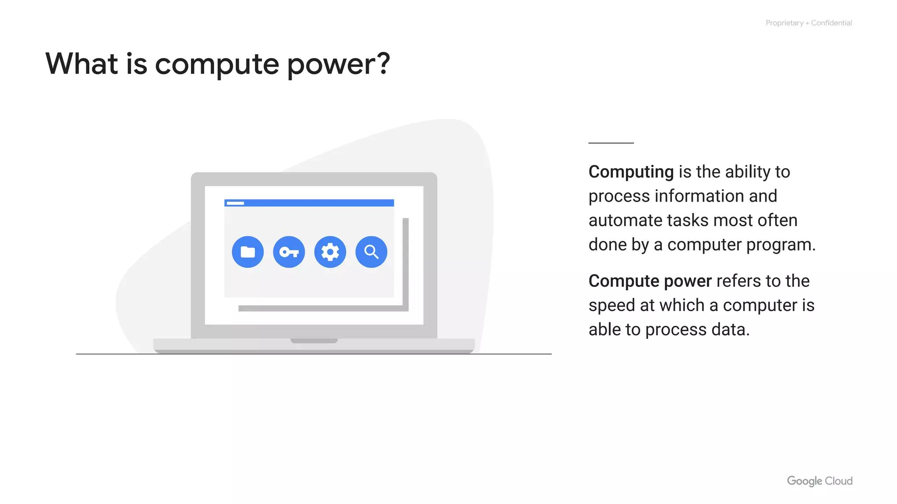
Run Resources
Run resources in regions
Natural disaster
Application
Notes:
You can run resources in different regions. This is useful for bringing applications closer to users around the world, and also for protection in case there are issues with an entire region, say, due to a natural disaster.

Slide 28
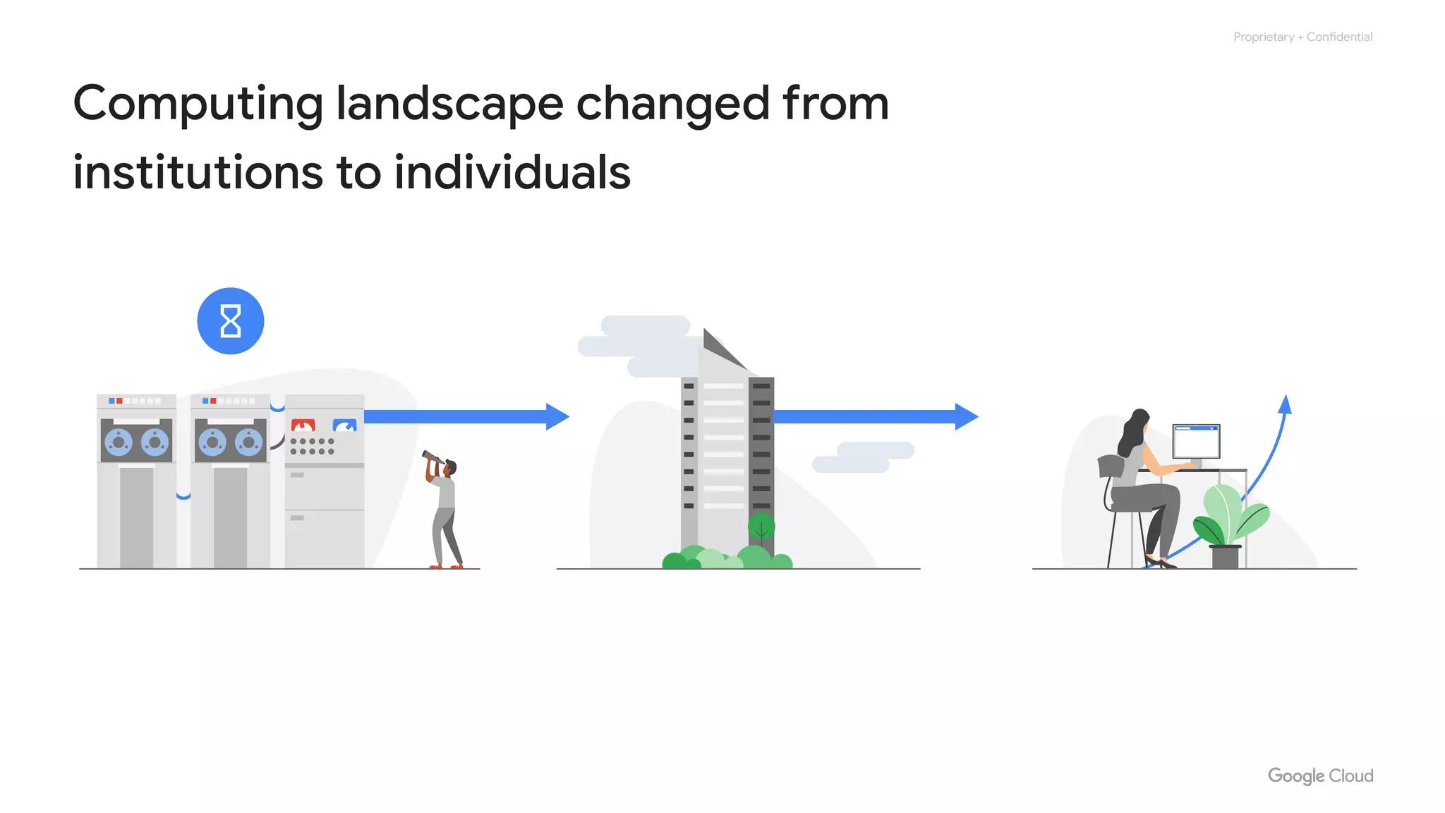
Multi-Region Services
Regions
Eur3 - Europe
The Netherlands
Belgium
Notes:
Some of Google Cloud’s services support placing resources in what we call a multi-region. For example, Spanner multi-region configurations allow you to replicate the database's data not just in multiple zones, but in multiple zones across multiple regions, as defined by the instance configuration.

Slide 29
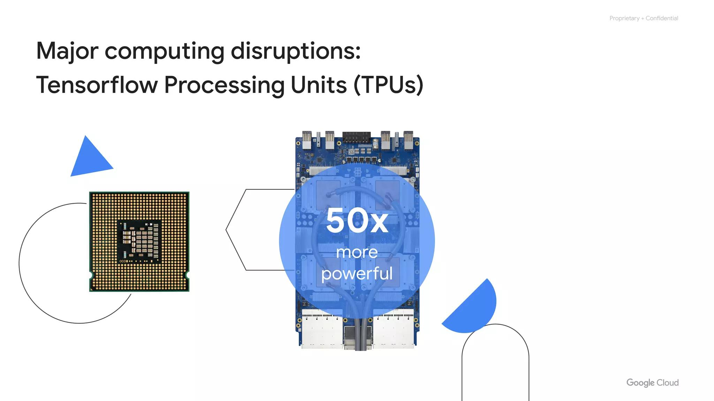
Zones and Regions
Zones
Regions
cloud.google.com/about/locations
Notes:
Google Cloud currently supports 121 zones in 40 regions, although this number is increasing all the time. The most up to date info can be found at cloud.google.com/about/locations.

Slide 30
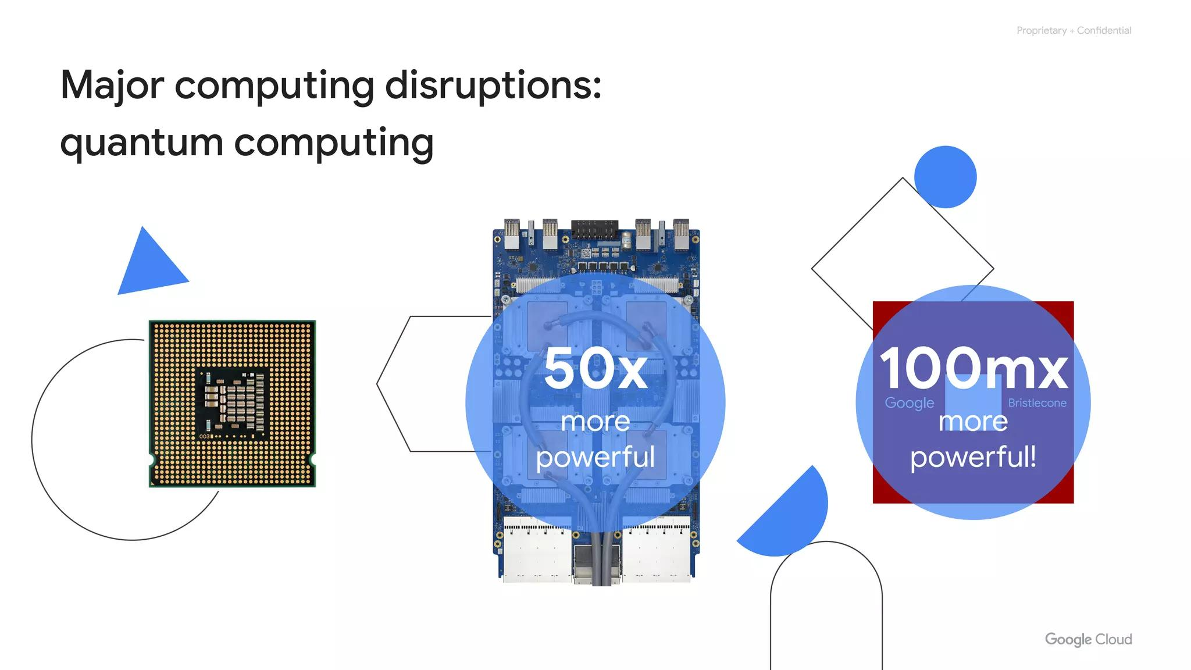
Environmental Impact
IaaS and PaaS
Google Cloud network
Environmental impact
Security
Open APIs and open source
Pricing and billing
Notes:
Now we will discuss the environmental impact of Google Cloud.

Slide 31
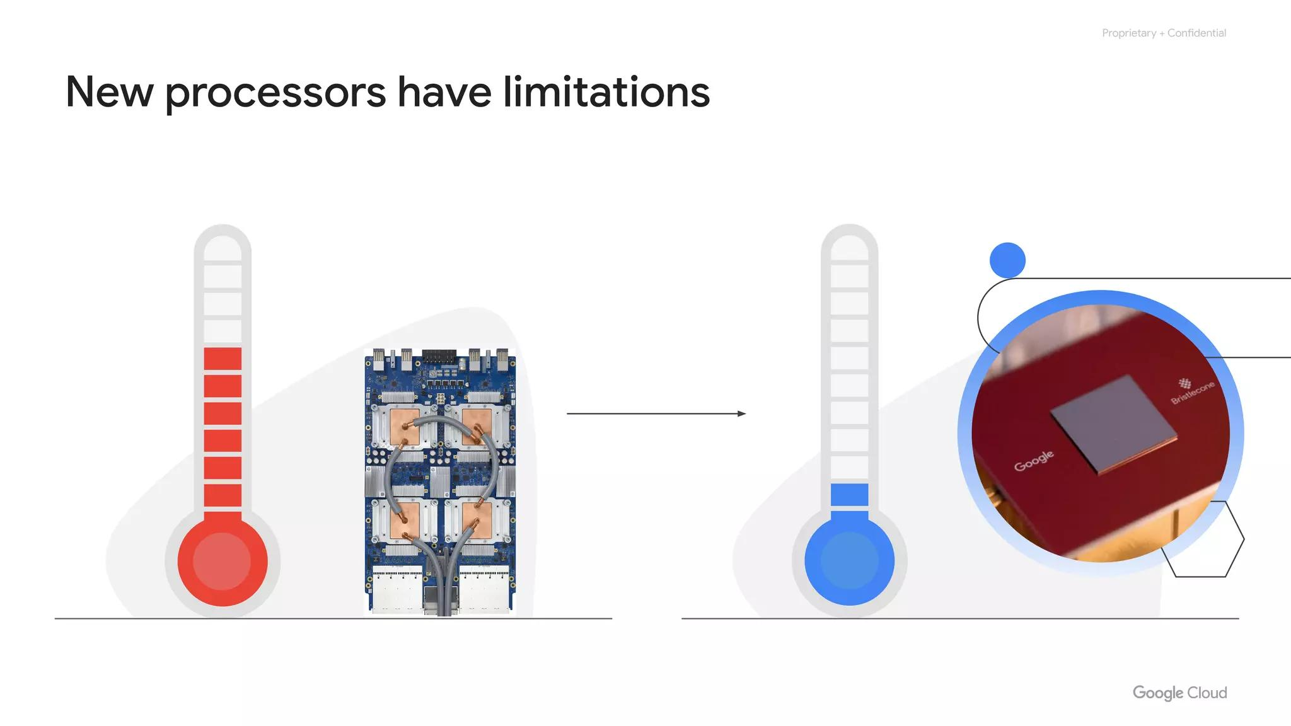
Data Center Consumption
2% of world's electricity
Data center consumption
Notes:
The virtual world, which includes Google Cloud’s network, is built on physical infrastructure, and all those racks of humming servers use huge amounts of energy. Together, all existing data centers use roughly 2% of the world’s electricity. So, Google works to make data centers run as efficiently as possible.

Slide 32
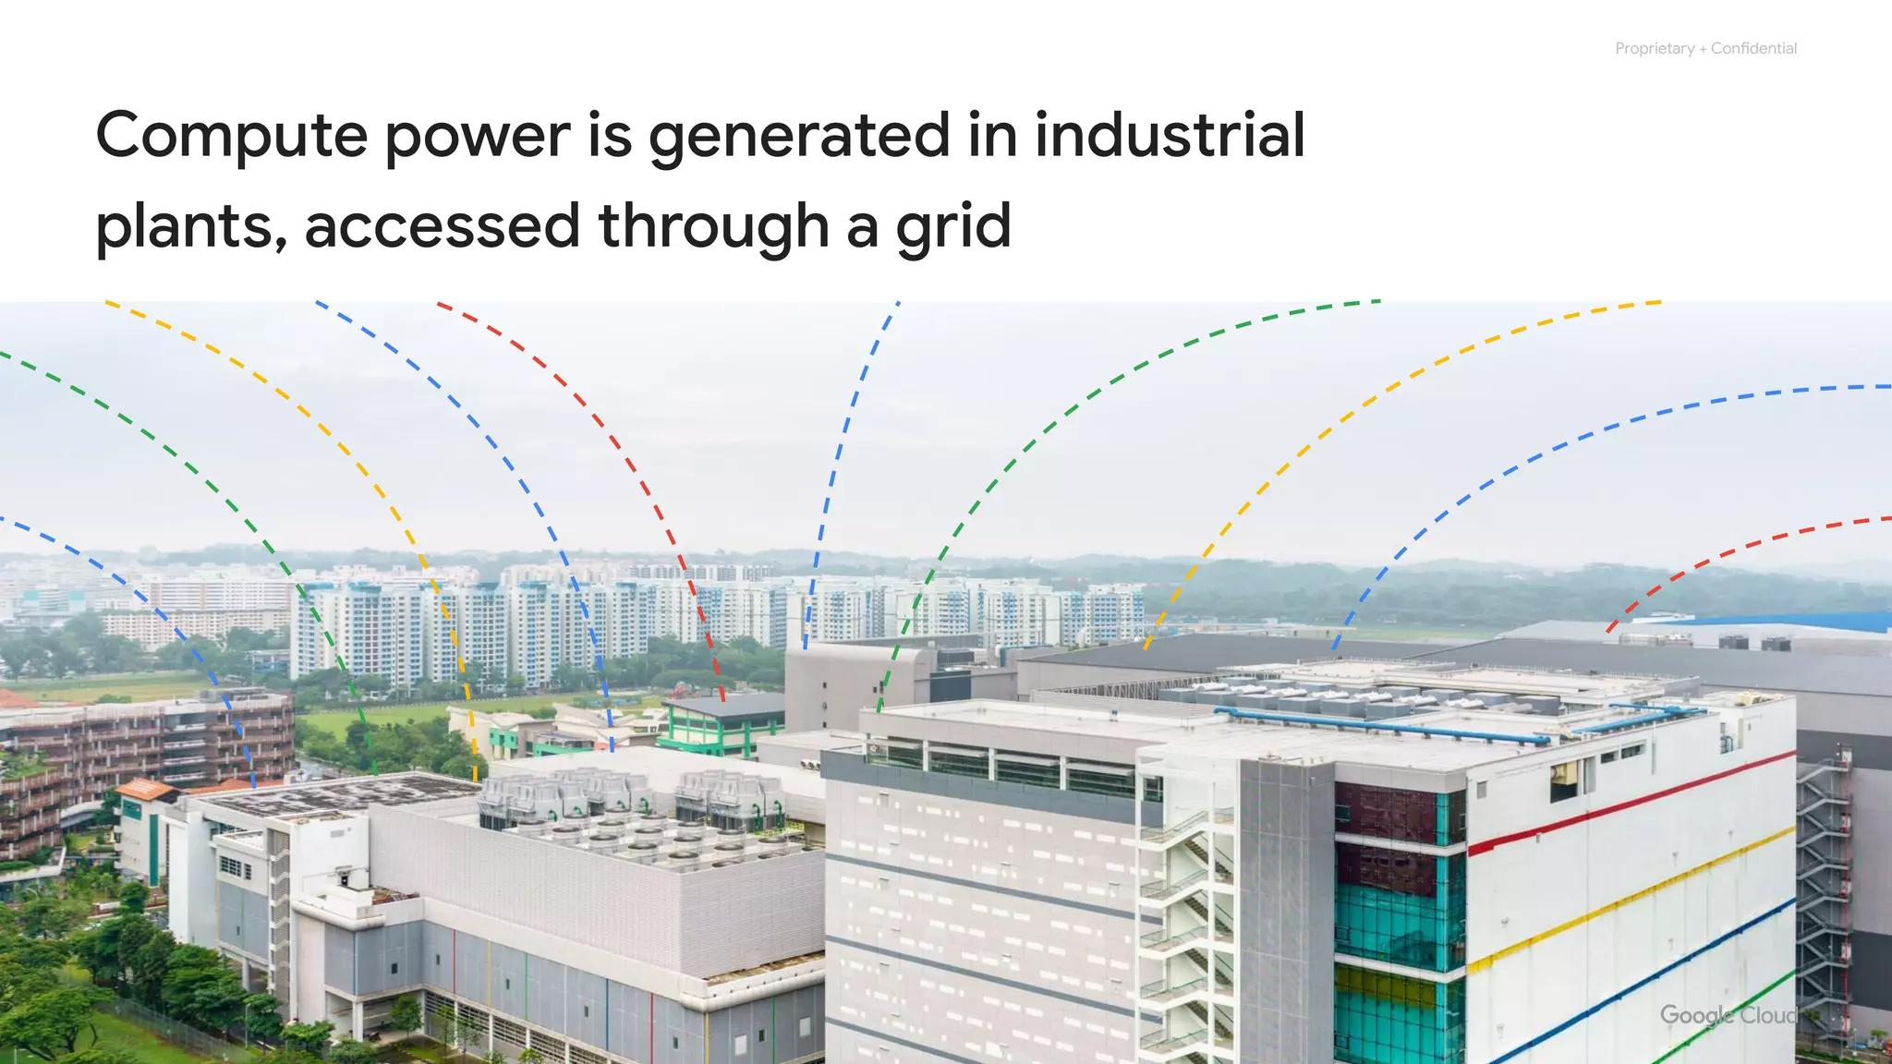
Efficiency and Waste
Google aims to improve
Efficiency and reduce waste
ISO 14001 certified
Notes:
Just like our customers, Google is trying to do the right things for the planet. We understand that Google Cloud customers have environmental goals of their own, and running their workloads in Google Cloud can be a part of meeting them. Therefore, it’s important to note that Google's data centers were the first to achieve ISO 14001 certification, which is a standard that maps out a framework for improving resource efficiency and reducing waste.

Slide 33
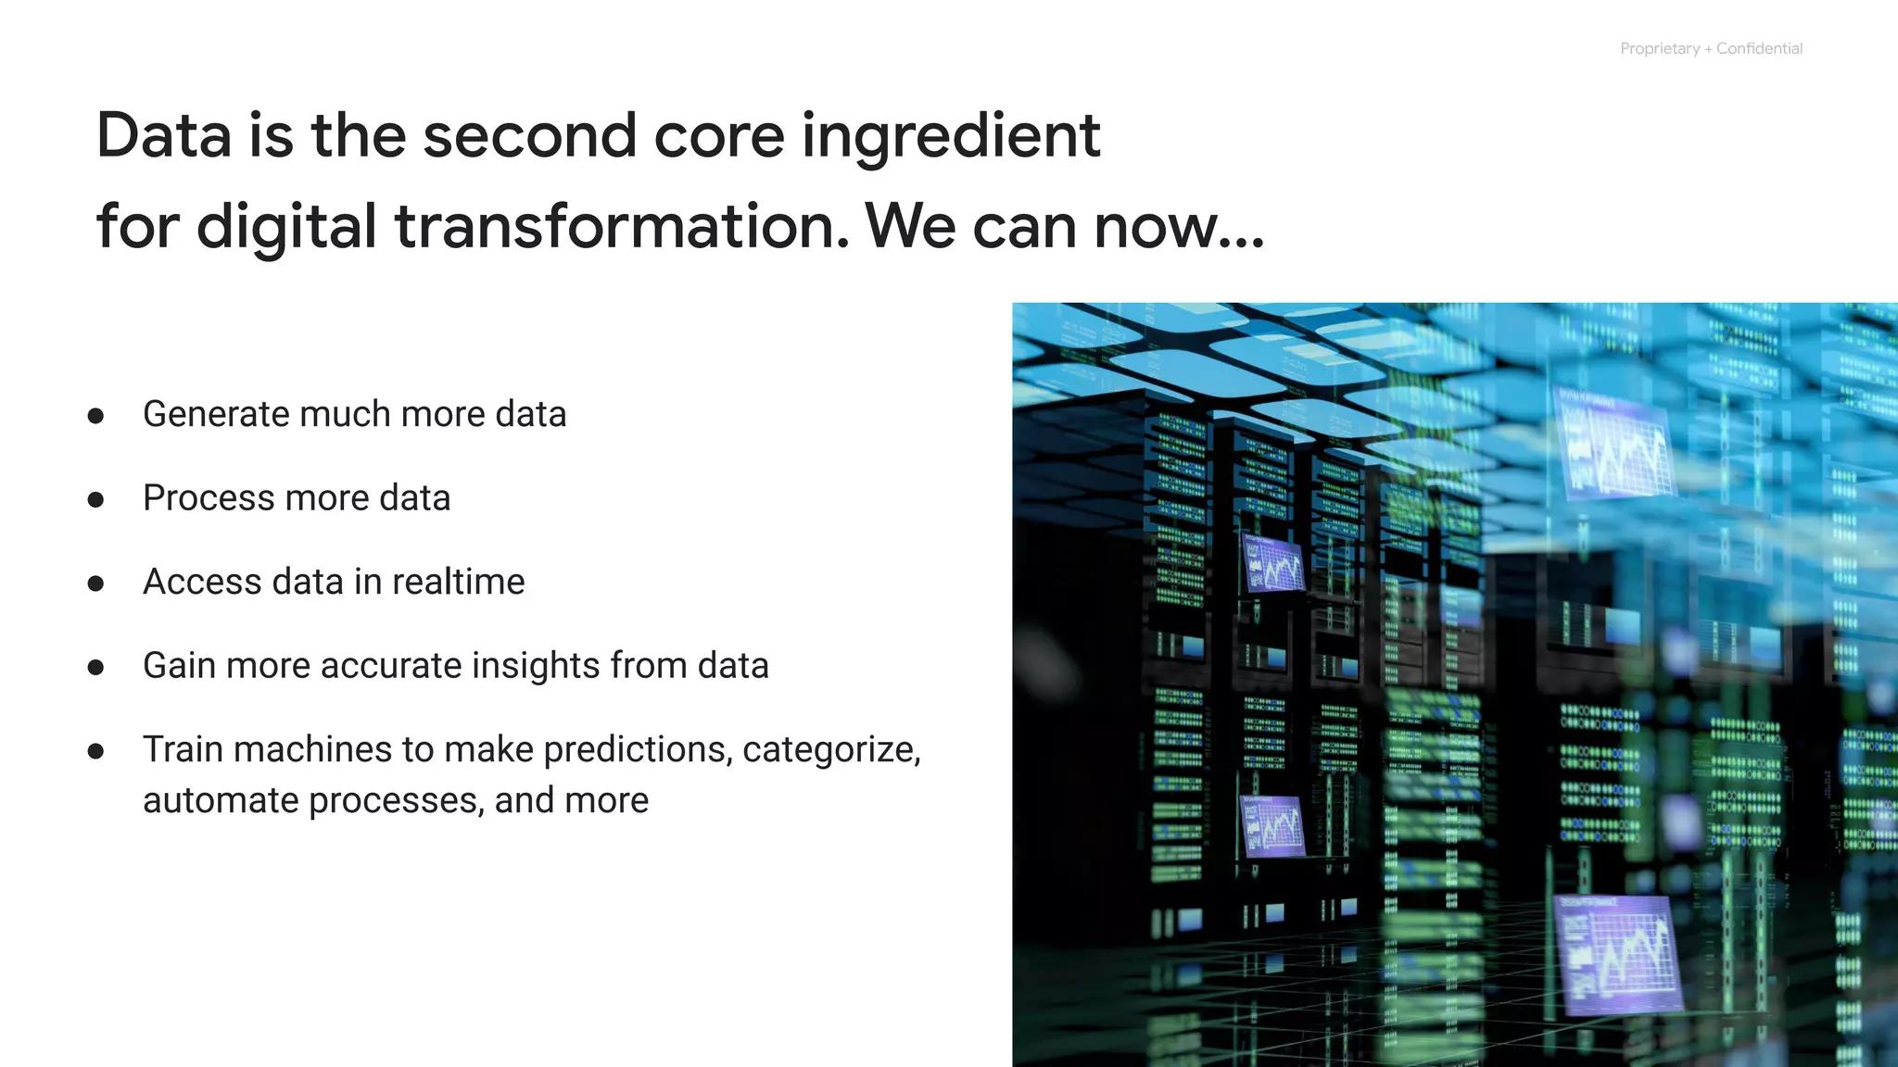
Hamina, Finland
Google’s data center
Hamina, Finland
Advanced and efficient
Notes:
This is Google’s data center in Hamina, Finland. The facility is one of the most advanced and efficient data centers in the Google fleet. Its cooling system, which uses sea water from the Bay of Finland, reduces energy use and is the first of its kind anywhere in the world.

Slide 34
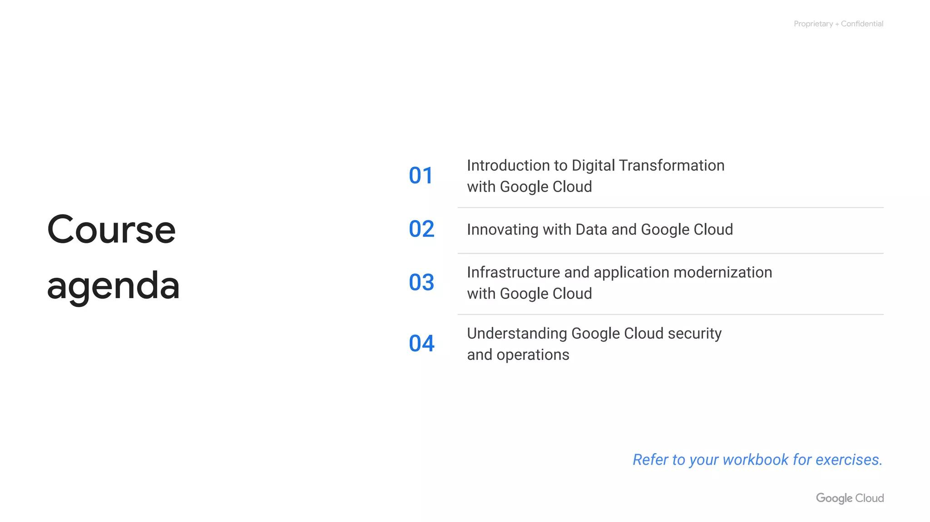
Sustainability Commitment
Renewable energy
Carbon neutral
Carbon free
100% by 2030
Notes:
In our founding decade, Google became the first major company to be carbon neutral. In our second decade, we were the first company to achieve 100% renewable energy. By 2030, we aim to be the first major company to operate carbon free.

Slide 35
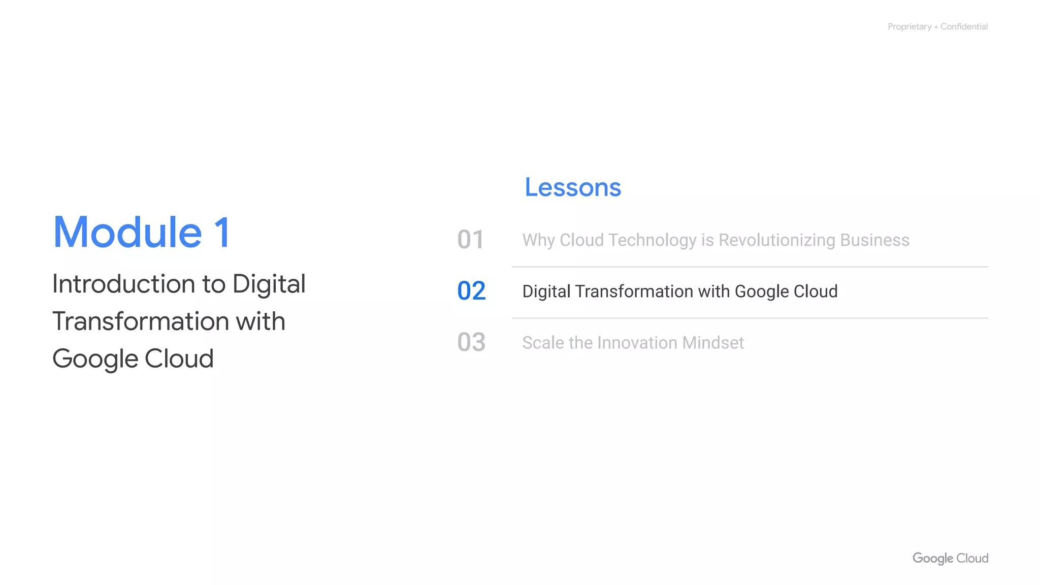
Security Focus
IaaS and PaaS
Google Cloud network
Environmental impact
Security
Open APIs and open source
Pricing and billing
Notes:
Let's now discuss security in Google Cloud.

Slide 36
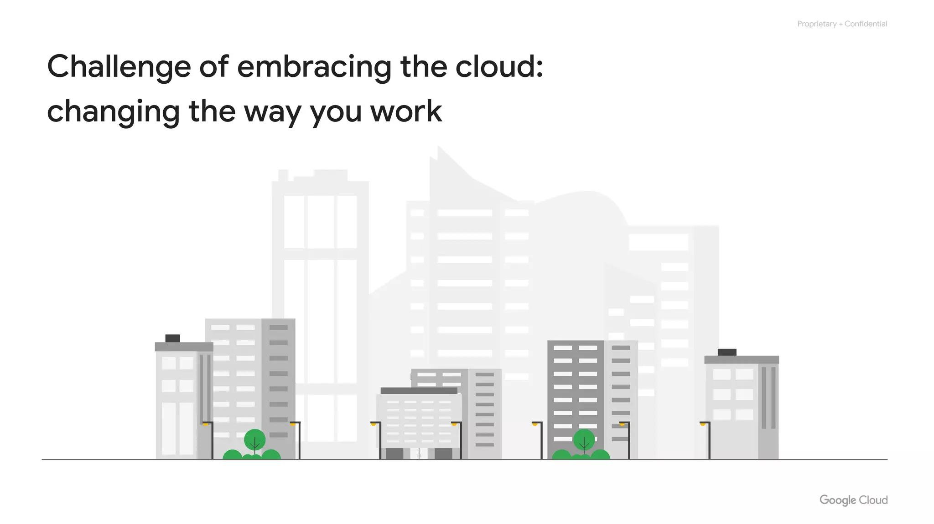
Designed For Security
Google Cloud is
Designed with
Security in mind
Notes:
Because Google has nine services with more than a billion users, you can bet security is always on the minds of Google's employees. Design for security is prevalent, throughout the infrastructure, that Google Cloud and Google services run-on.

Slide 37
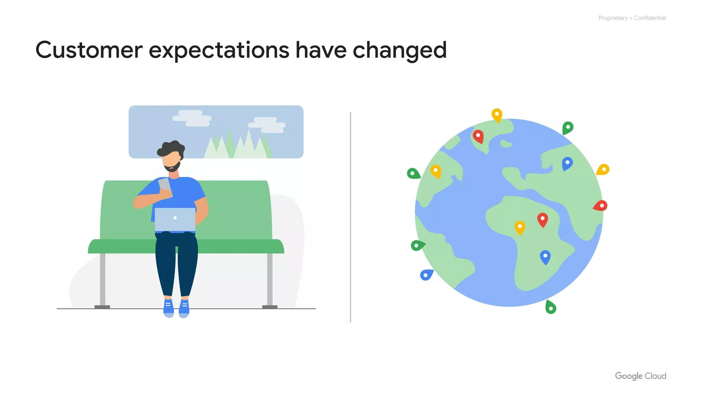
Hardware Infrastructure
Hardware infrastructure level
Notes:
At the Hardware infrastructure level:

Slide 38
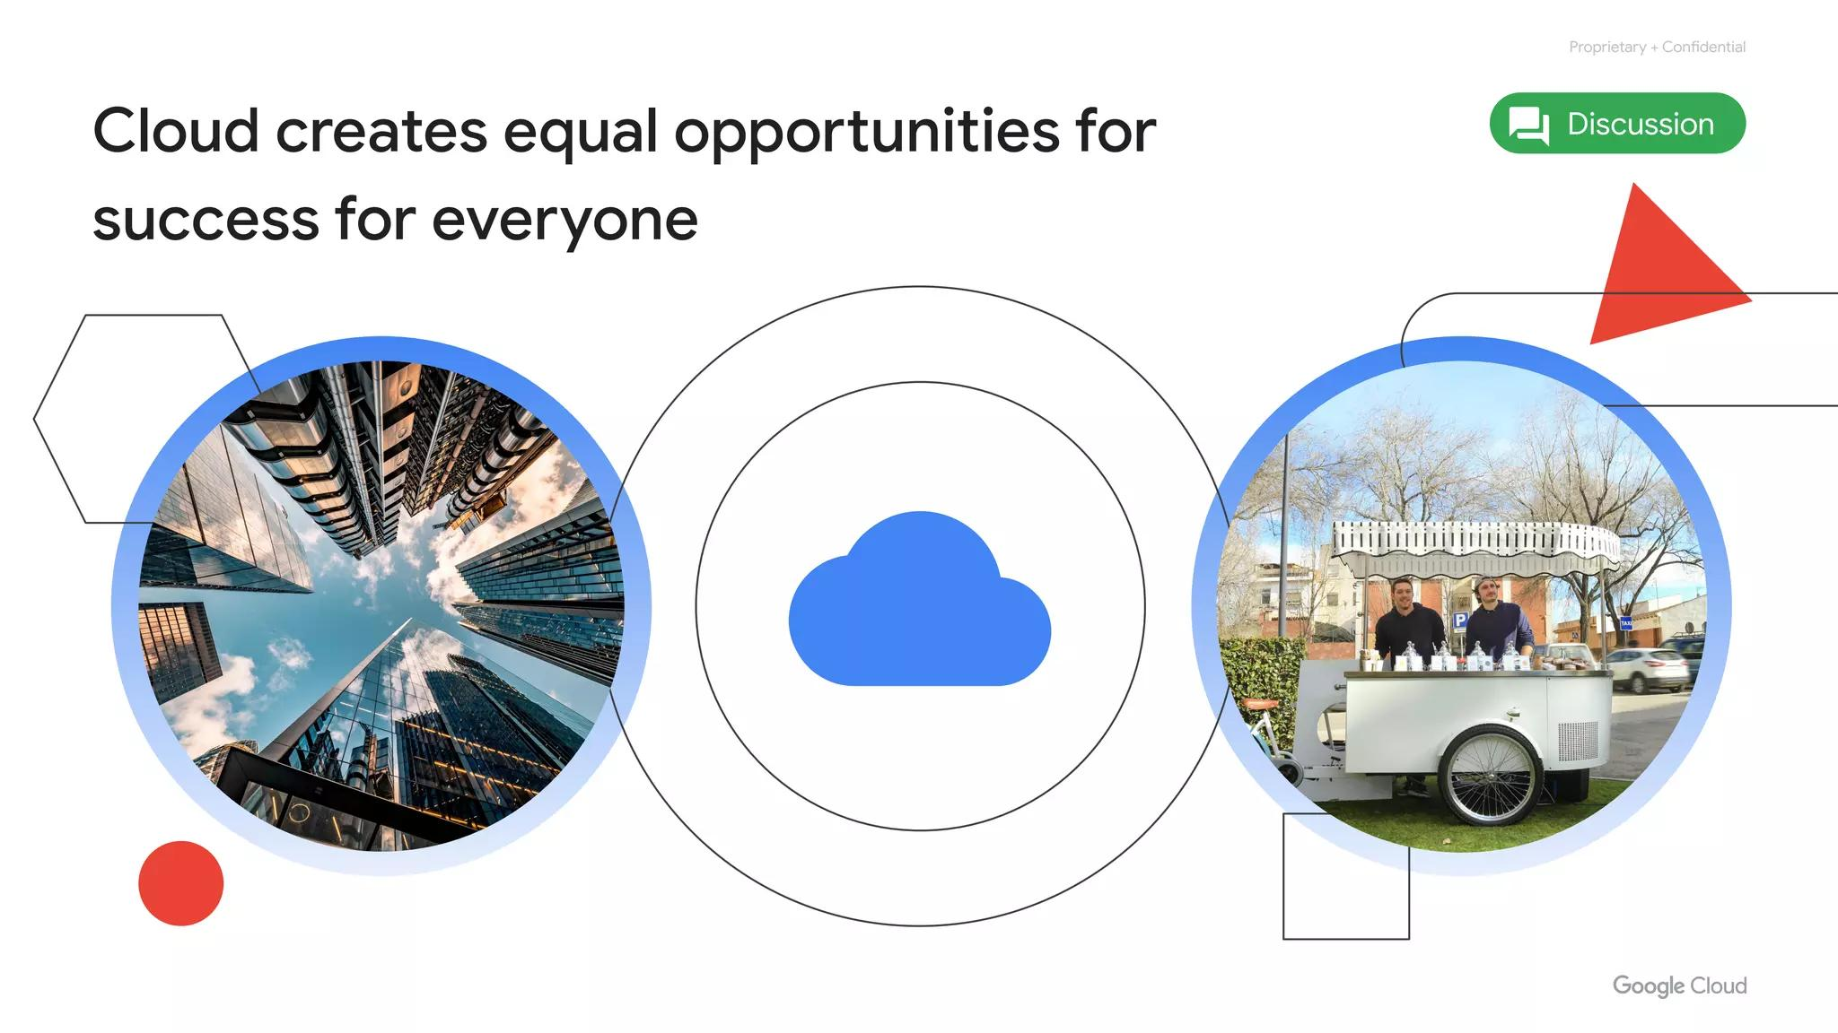
Hardware
Hardware design
Secure boot stack
Premises security
Notes:
Hardware design and provenance: Both the server boards and the networking equipment in Google data centers are custom designed by Google. Google also designs custom chips, including a hardware security chip that's currently being deployed on both servers and peripherals. Secure boot stack: Google server machines use a variety of technologies to ensure that they are booting the correct software stack, such as cryptographic signatures over the BIOS, bootloader, kernel, and base operating system image. Premises security: Google designs and builds its own data centers, which incorporate multiple layers of physical security protections. Access to these data centers is limited to only a very small fraction of Google employees.

Slide 39
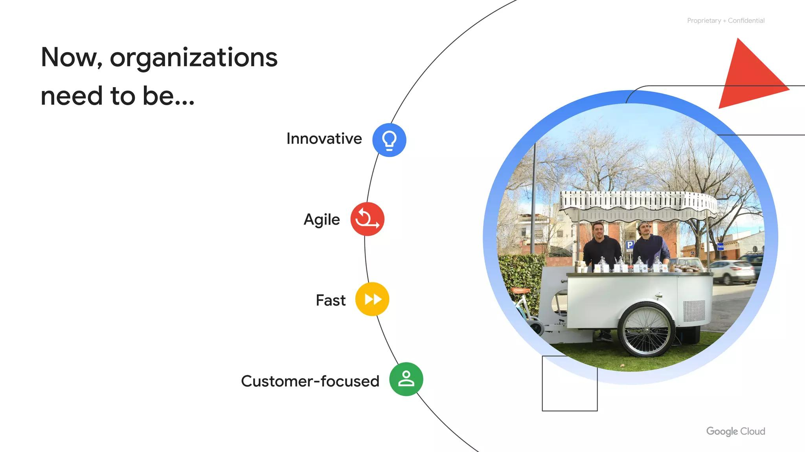
Service Deployment
Service deployment level
Notes:
At the Service deployment level:

Slide 40
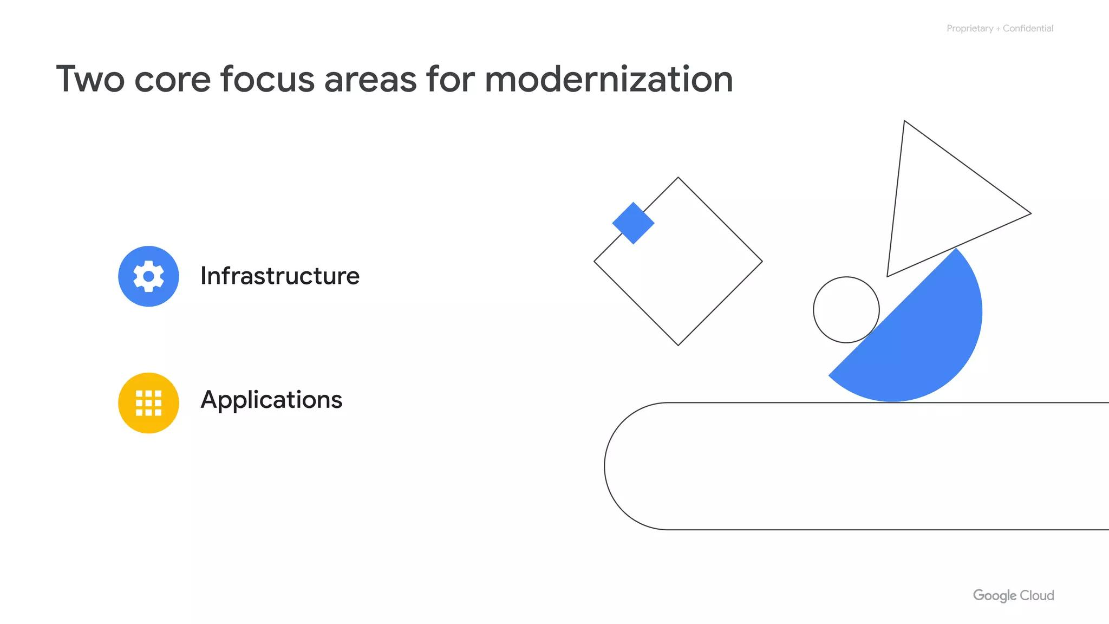
Inter-Service
Encryption of
Inter-service communication
Services use RPCs
Notes:
Encryption of inter-service communication: Google’s infrastructure provides cryptographic privacy and integrity for remote procedure call (“RPC”) data on the network. Google’s services communicate with each other using RPC calls. The infrastructure automatically encrypts all infrastructure RPC traﬃc which goes between data centers.

Slide 41
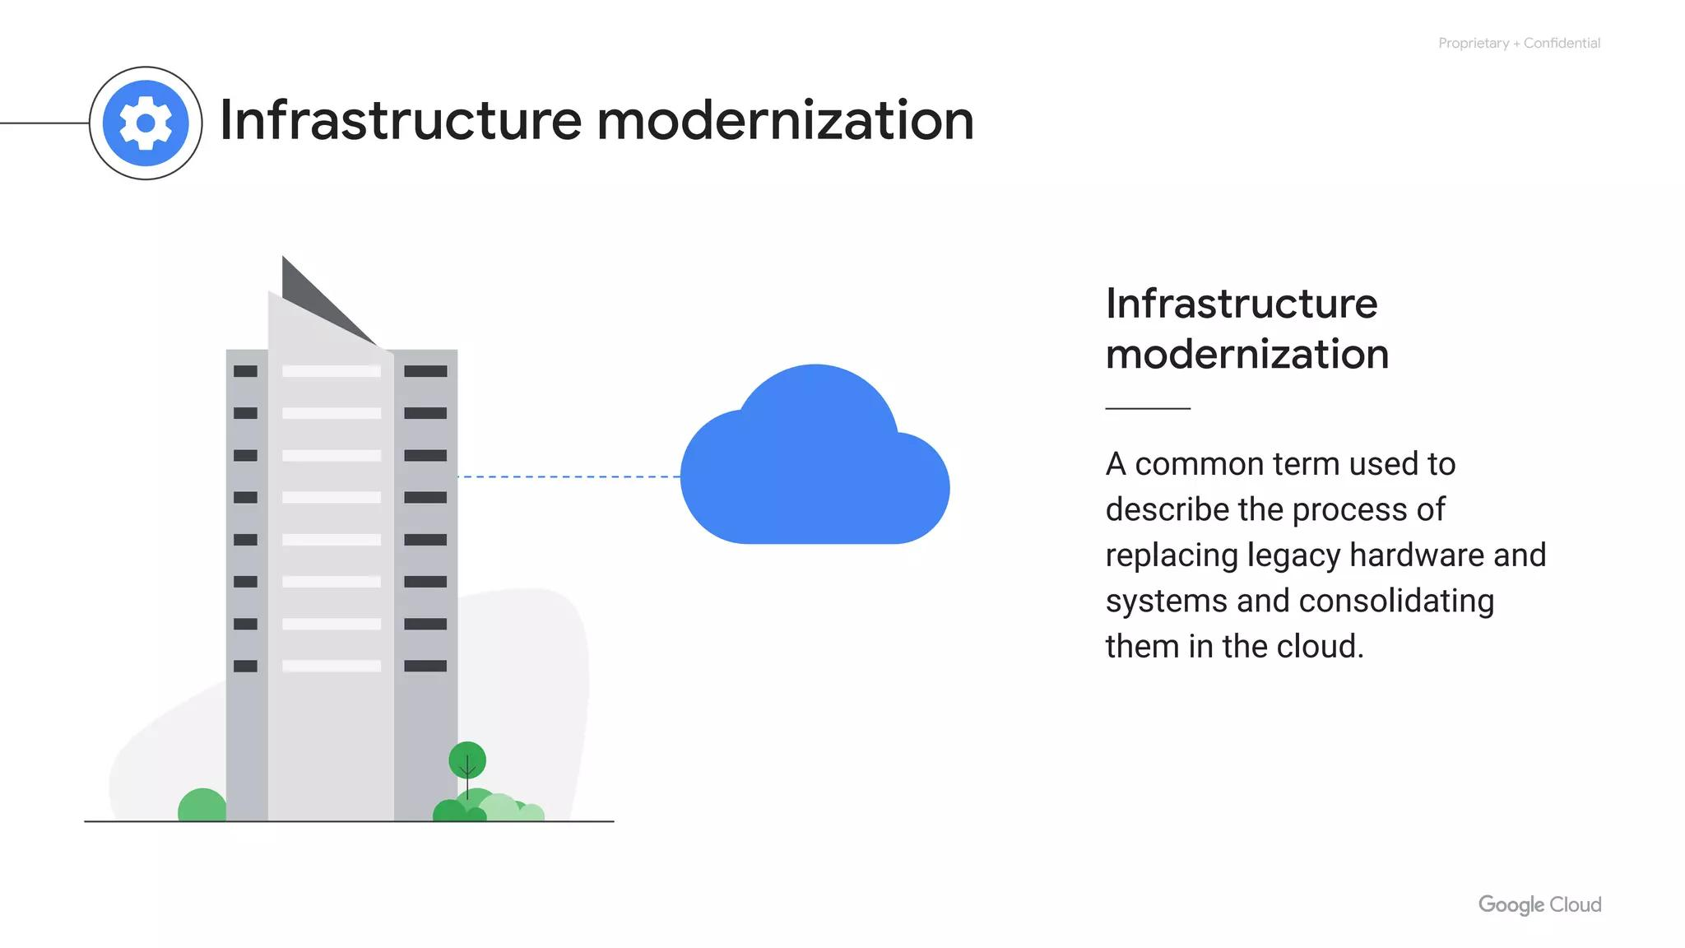
User Identity
User identity level
Notes:
At the User identity level:

Slide 42
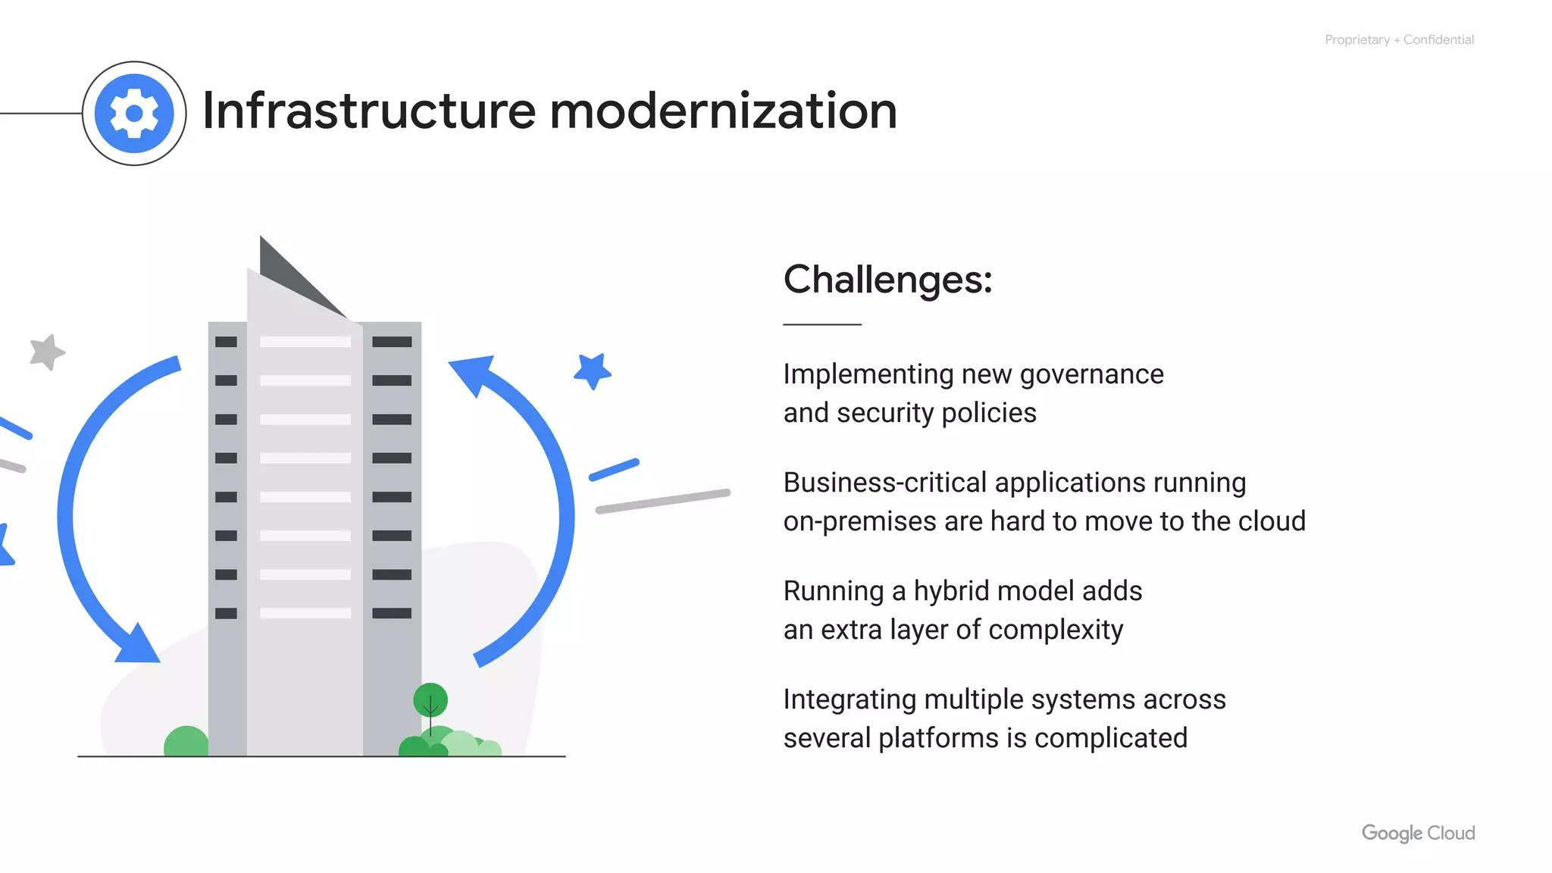
Centralized Services
Intelligently challenges users
Users can use secondary factors
Including U2F open standard
Notes:
User identity: Google’s central identity service, which usually manifests to end users as the Google login page, goes beyond asking for a simple username and password. The service also intelligently challenges users for additional information based on risk factors such as whether they have logged in from the same device or a similar location in the past. Users also have the option of employing secondary factors when signing in, including devices based on the Universal 2nd Factor (U2F) open standard.

Slide 43
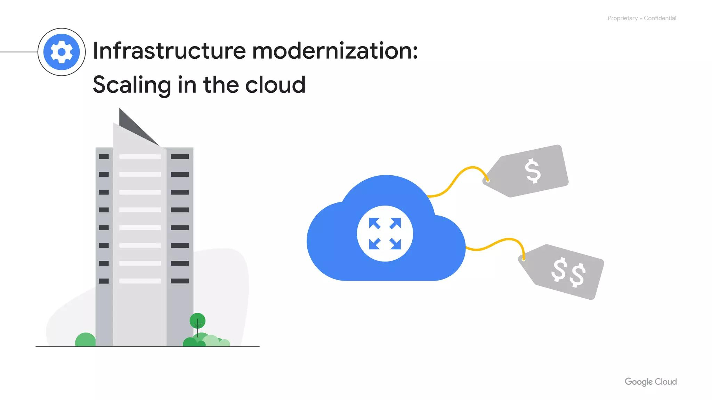
Storage Services
Storage services level
Notes:
At the Storage services level:

Slide 44
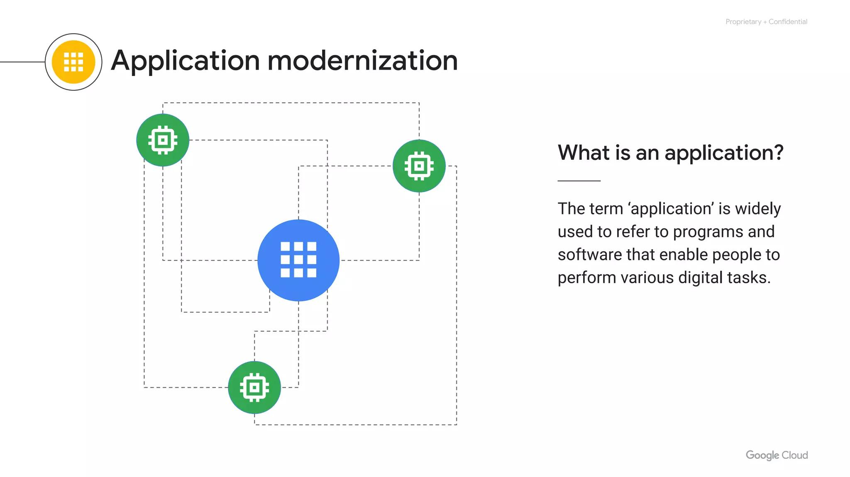
Encryption At Rest
Encryption at rest
Indirectly via storage services
Centrally managed keys
Notes:
Encryption at rest: Most applications at Google access physical storage (in other words, “file storage”) indirectly via storage services, and encryption (using centrally managed keys) is applied at the layer of these storage services. Google also enables hardware encryption support in hard drives and SSDs.

Slide 45
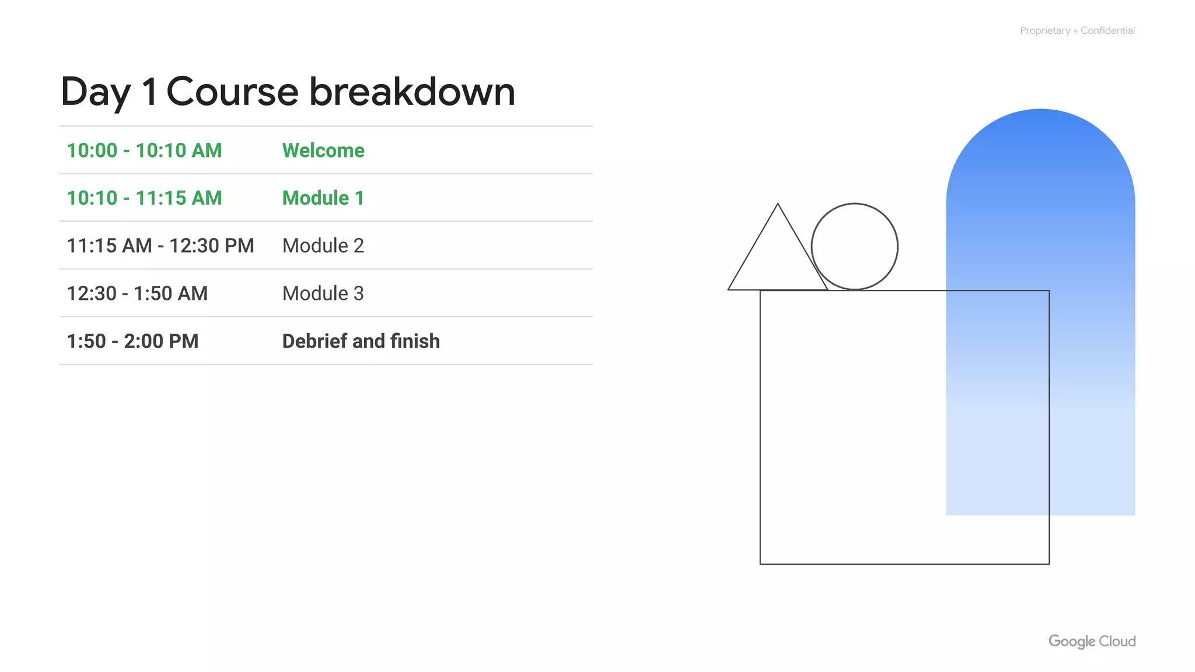
Internet Communication
Internet communication level
Notes:
At the Internet communication level:

Slide 46
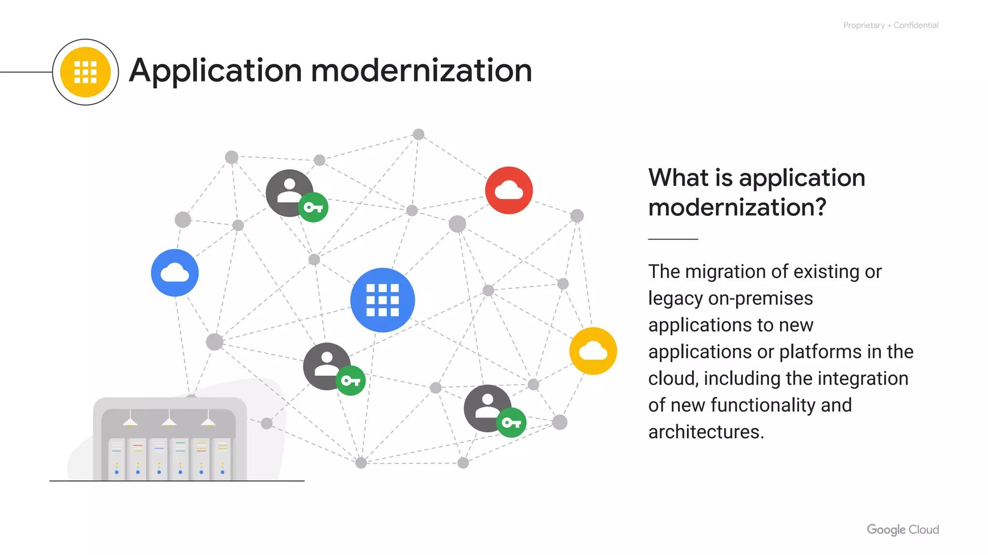
DoS Protection
Google Front End (“GFE”)
Denial of Service (“DoS”) protection
Notes:
Google Front End (“GFE”): Google services that want to make themselves available on the Internet register themselves with an infrastructure service called the Google Front End, which ensures that all TLS connections are ended using a public-private key pair and an X.509 certiﬁcate from a Certiﬁed Authority (CA) as well as following best practices such as supporting perfect forward secrecy. The GFE additionally applies protections against Denial of Service attacks. Denial of Service (“DoS”) protection: The sheer scale of its infrastructure enables Google to simply absorb many DoS attacks.

Slide 47
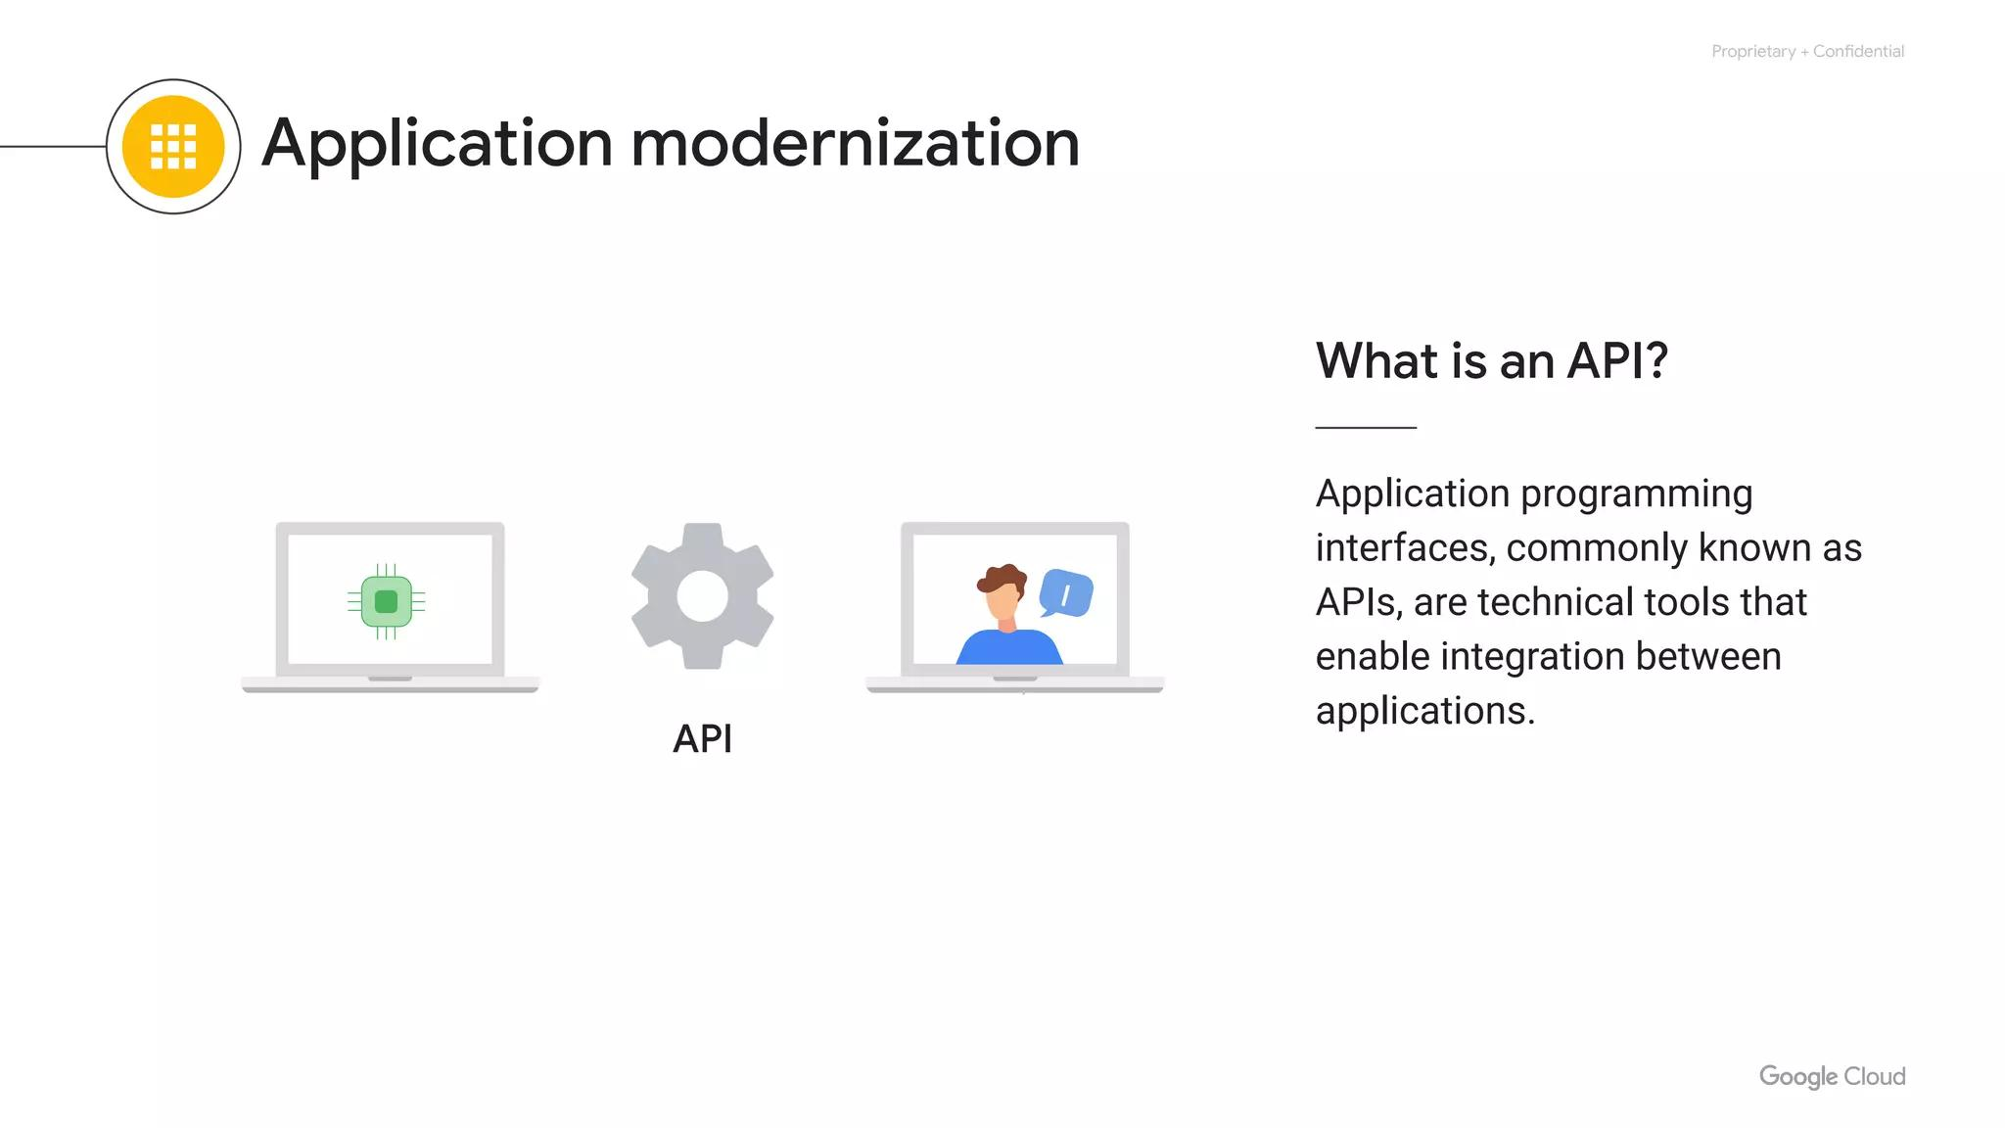
Operational Security
Operational security level
Notes:
Finally, at Google’s Operational security level:

Slide 48
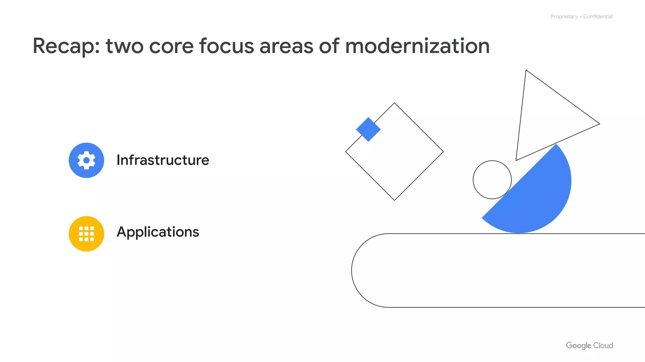
Machine Intelligence
Intrusion detection
Reducing insider risk
Employee U2F use
Software development practices
Notes:
Intrusion detection: Rules and machine intelligence give Google’s operational security teams warnings of possible incidents. Google conducts Red Team exercises to measure and improve the effectiveness of its detection and response mechanisms. Reducing insider risk: Google aggressively limits and actively monitors the activities of employees who have been granted administrative access to the infrastructure. Employee U2F use: To guard against phishing attacks against Google employees, employee accounts require use of U2F-compatible Security Keys.

Slide 49
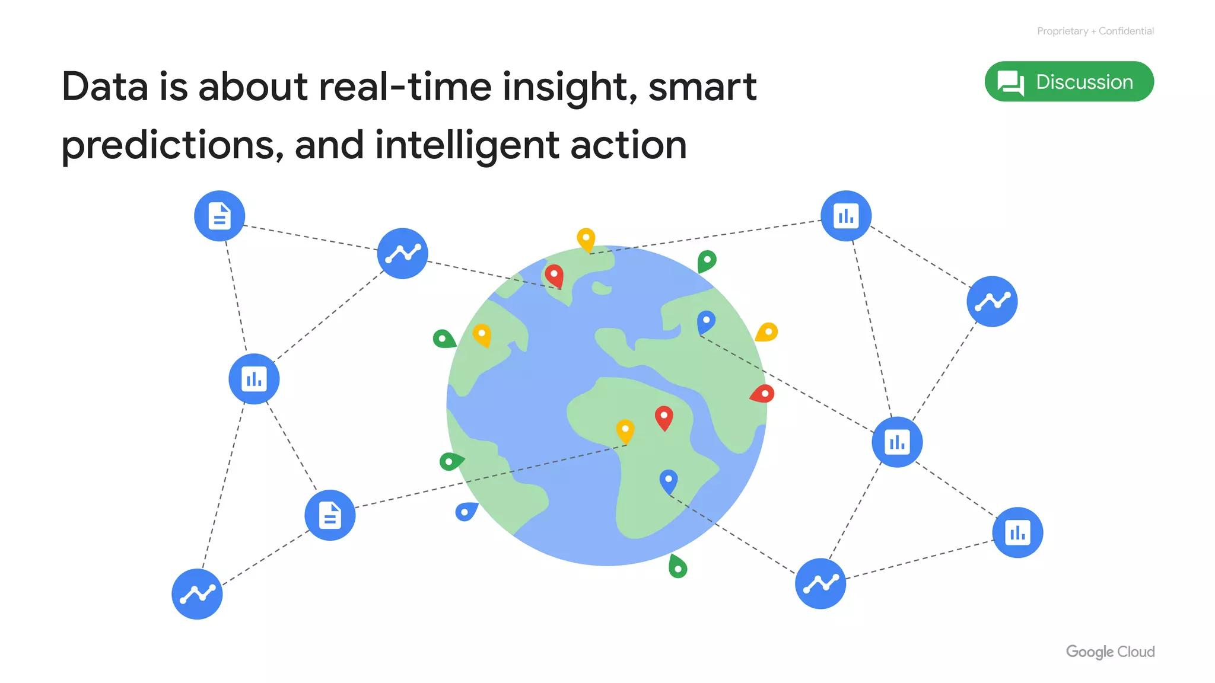
Security Design
More info:
cloud.google.com/security/security-design
Notes:
You can learn more about Google’s technical-infrastructure security at cloud.google.com/security/security-design.

Slide 50
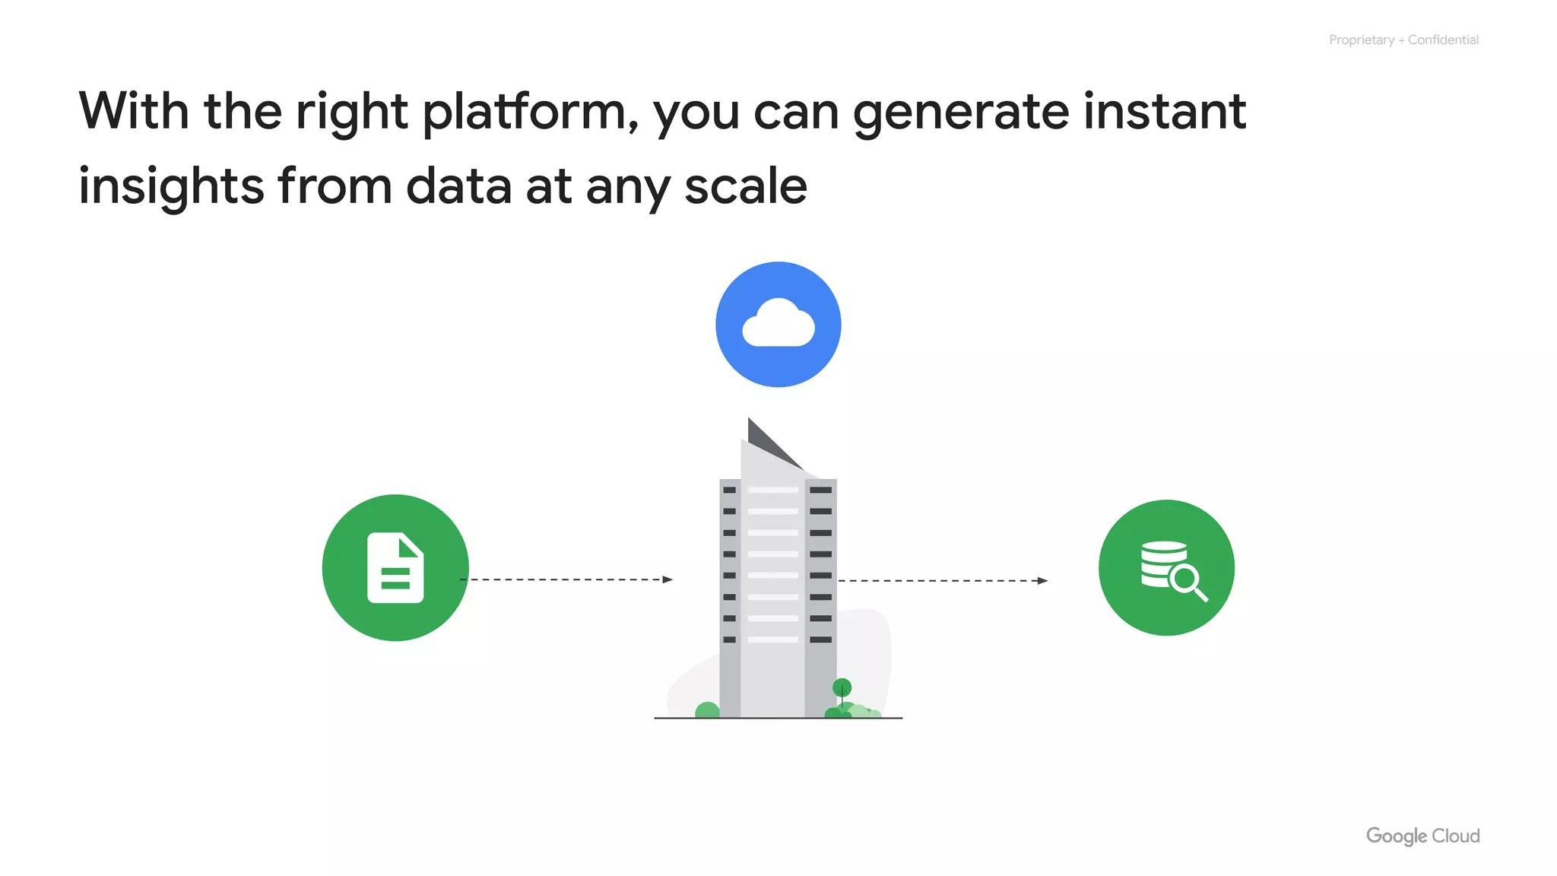
Open Source Focus
IaaS and PaaS
Google Cloud network
Environmental impact
Security
Open APIs and open source
Pricing and billing
Notes:
Here is a discussion on open APIs and open source in Google Cloud.

Slide 51

Open-Source Friendly
Avoid vendor lock-in
Run applications elsewhere
Publish open source tech
Notes:
Some people are afraid to bring their workloads to the cloud because they're afraid they'll get locked into a particular vendor. But if, for whatever reason, a customer decides that Google is no longer the best provider for their needs, we give customers the ability to run their applications elsewhere. Google publishes key elements of technology using open source licenses to create ecosystems that provide customers with options other than Google.

Slide 52

TensorFlow Ecosystem
TensorFlow is open source
Library for machine learning
Works with Google Cloud
Notes:
For example, TensorFlow, an open source software library for machine learning developed inside Google, is at the heart of a strong open source ecosystem.

Slide 53

Interoperability
Mix and match microservices
Across different clouds
Kubernetes
GKE
Cloud Observability
Notes:
Google provides interoperability at multiple layers of the stack. Kubernetes and Google Kubernetes Engine give customers the ability to mix and match microservices running across different clouds. Google Cloud Observability lets customers monitor workloads across multiple cloud providers.

Slide 54

Pricing Structure
IaaS and PaaS
Google Cloud network
Environmental impact
Security
Open APIs and open source
Pricing and billing
Notes:
Now a word on Google Cloud’s pricing structure.

Slide 55

Per-Second Billing
Google Compute products
Billed per-second
Notes:
Google was the first major cloud provider to deliver per-second billing for its Infrastructure-as-a-Service compute offering, Compute Engine. We’ll explore these products and services later in this course, but per-second billing is offered for users of Compute Engine, Google Kubernetes Engine (container infrastructure as a service), Dataproc (which is the equivalent of the big data system Hadoop, but operating as a service), and App Engine ﬂexible environment VMs (a platform as a service).

Slide 56

Billing Flexibility
Compute Engine offers:
Sustained-use discounts
Custom virtual machine types
Notes:
Compute Engine offers automatically applied sustained-use discounts, which are automatic discounts that you get for running a virtual-machine instance for a signiﬁcant portion of the billing month. Speciﬁcally, when you run an instance for more than 25% of a month, Compute Engine automatically gives you a discount for every incremental minute you use for that instance. Custom virtual machine types allow Compute Engine virtual machines to be ﬁne-tuned with optimal amounts of vCPU and memory for their applications, so that you can tailor your pricing for your workloads.

Slide 57

Pricing Calculator
Estimate
Instances
cloud.google.com/products/calculator
Notes:
Our online pricing calculator can help estimate your costs. Visit cloud.google.com/products/calculator to try it out.

Slide 58

Budget and Monitor
Budget
Alerts
Reports
Quotas
Notes:
We provide a few tools to help make sure you don’t accidentally run up a big Google Cloud bill. You can define budgets at the billing account level or at the project level. To be notified when costs approach your budget limit, you can create an alert. Reports is a visual tool in the Google Cloud console that allows you to monitor expenditure based on a project or services. Finally, Google Cloud also implements quotas, which are designed to prevent the over-consumption of resources because of an error or a malicious attack, protecting both account owners and the Google Cloud community as a whole.

Slide 59

Project-Level Quotas
Governs the number
of resources in a project
Allocation quota
Rate quota
Notes:
There are two types of quotas: rate quotas and allocation quotas. Both are applied at the project level. Rate quotas reset after a specific time. Allocation quotas govern the number of resources you can have in your projects.

Slide 60

Module Quiz
Notes:
Let's check your knowledge with a quiz!

Slide 61

Quiz Question 1
Benefit of zones in a region?
A. Fault tolerance
B. Performance
C. Expand services
D. Zone discounts
Notes:
What is the primary benefit to a Google Cloud customer of using resources in several zones within a region?

Slide 62

Quiz Answer 1
A. Improved fault tolerance
Building fault tolerance
Spread resources
Notes:
Why might a Google Cloud customer use resources in several zones within a region? A: For improved fault tolerance - Correct. As part of building a fault-tolerant application, you can spread your resources across multiple zones in a region. The other answers are not correct, the primary benefit is for improved fault tolerance.

Slide 63

Quiz Question 2
Type of cloud service?
Code to libraries for access
A. Hybrid Cloud
B. IaaS
C. SaaS
D. PaaS
E. Virtualized data centers
Notes:
What type of cloud computing service lets you bind your application code to libraries that give access to the infrastructure your application needs?

Slide 64

Quiz Answer 2
D. Platform as a Service
Correct!
Notes:
What type of cloud computing service lets you bind your application code to libraries that give access to the infrastructure your application needs? D: Platform as a Service - Correct!

Slide 65

Quiz Question 3
Resources in world regions?
A. Security
B. Discounts
C. Localized app versions
D. Closer to users, fault tolerance
Notes:
Why might a Google Cloud customer use resources in several regions around the world?

Slide 66

Quiz Answer 3
D. Closer to users
Improved fault tolerance
Correct!
Notes:
Why might a Google Cloud customer use resources in several regions around the world? D: To bring their applications closer to users around the world, and for improved fault tolerance - That is correct.

